Slide 1
Lecture Notes: Light Scattering, Image Formation, Digital Images, and Matlab
. 1. %. {. . {. . . . . . . .
. 1. %. {. . {. . . . . . . .

Slide 2
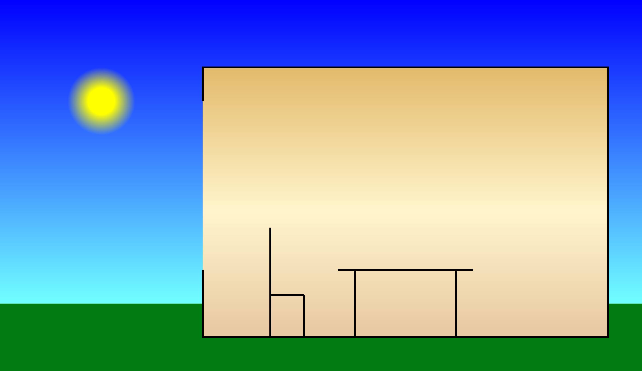
Light from a source …

Slide 3
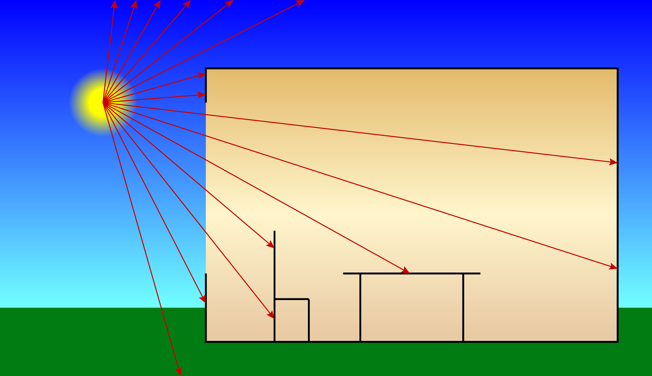
… illuminates a scene.

Slide 4
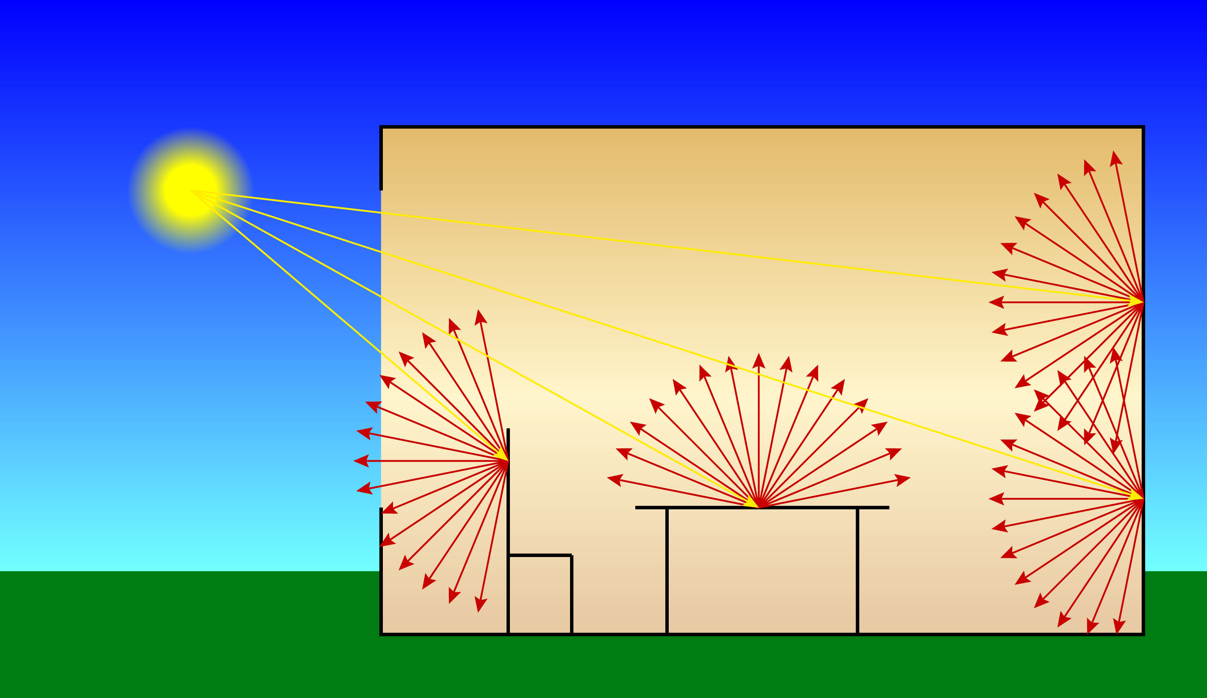
Each surface scatters light …

Slide 5
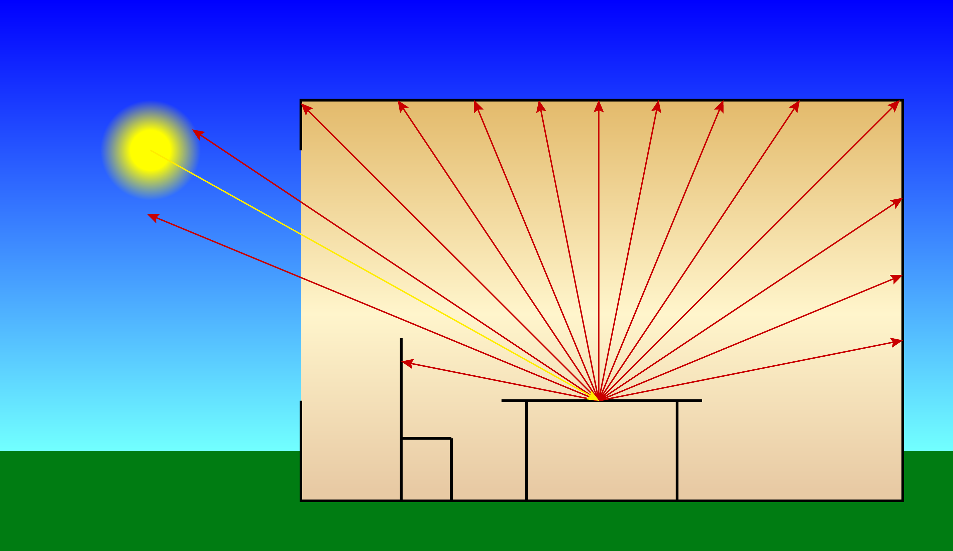
… that illuminates other surfaces …

Slide 6
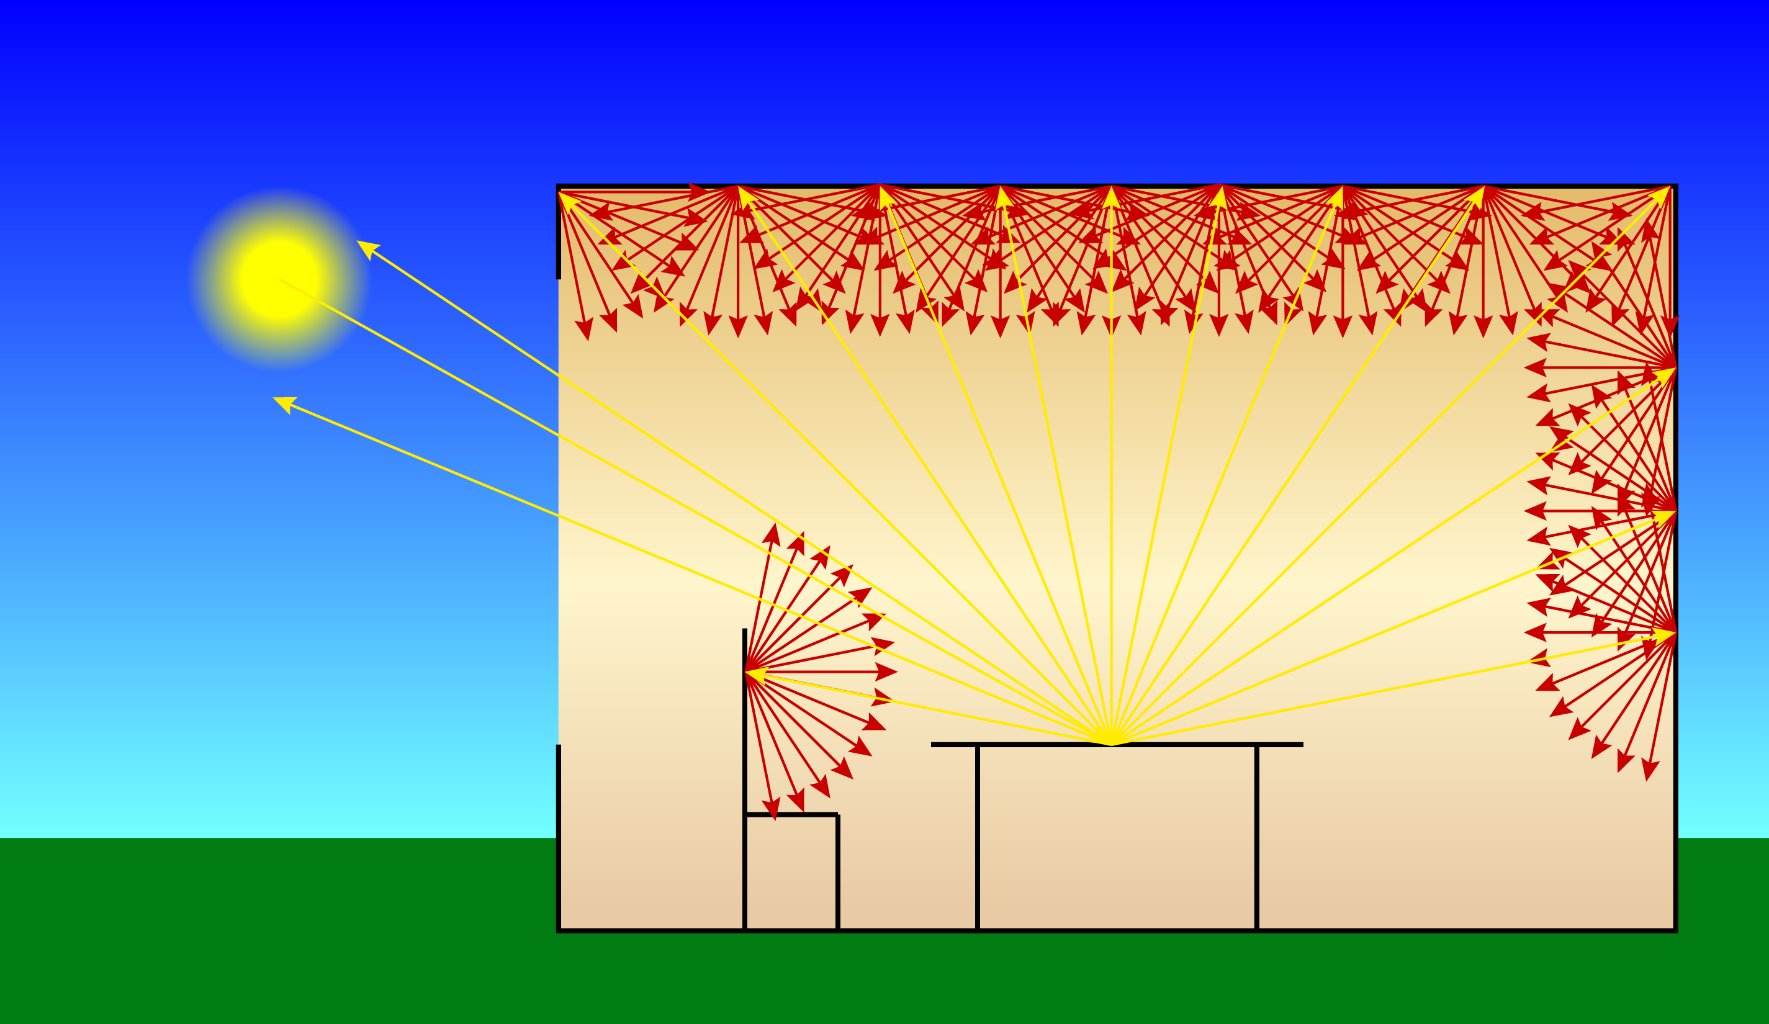
.. that scatter light.

Slide 7
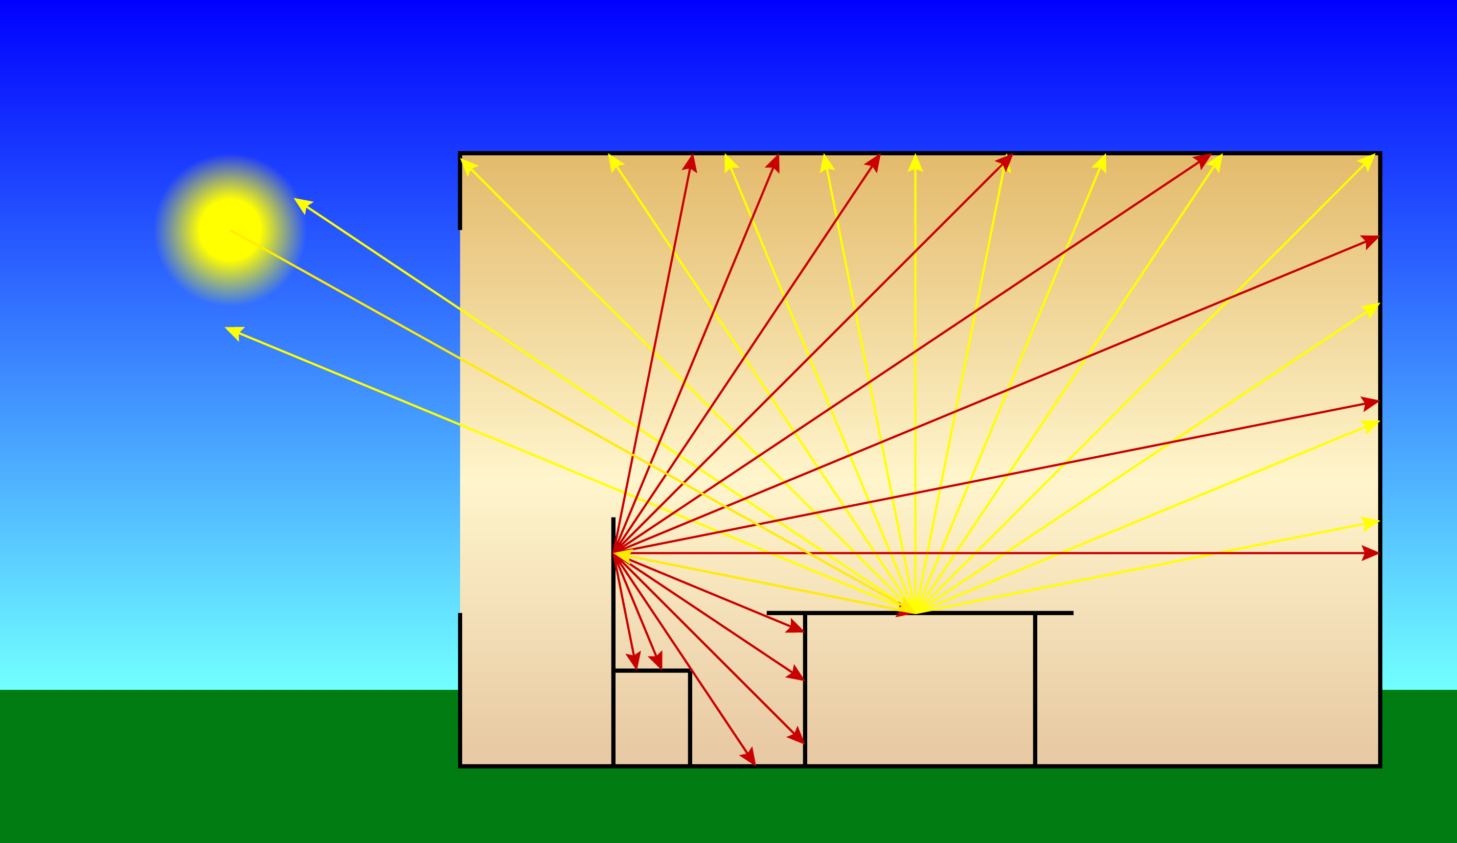
The degree of interreflection …

Slide 8
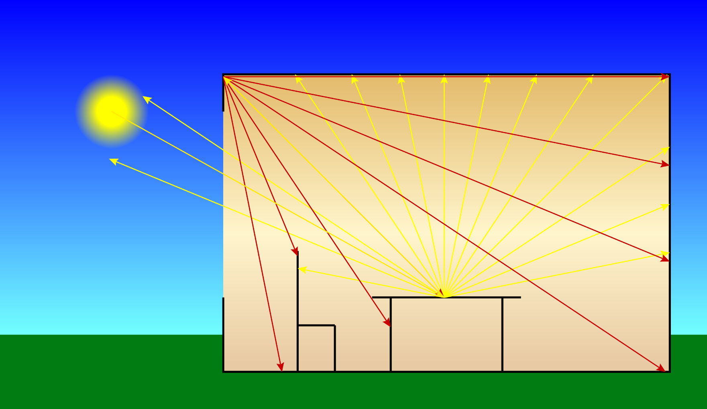
... depends on the material properties …

Slide 9
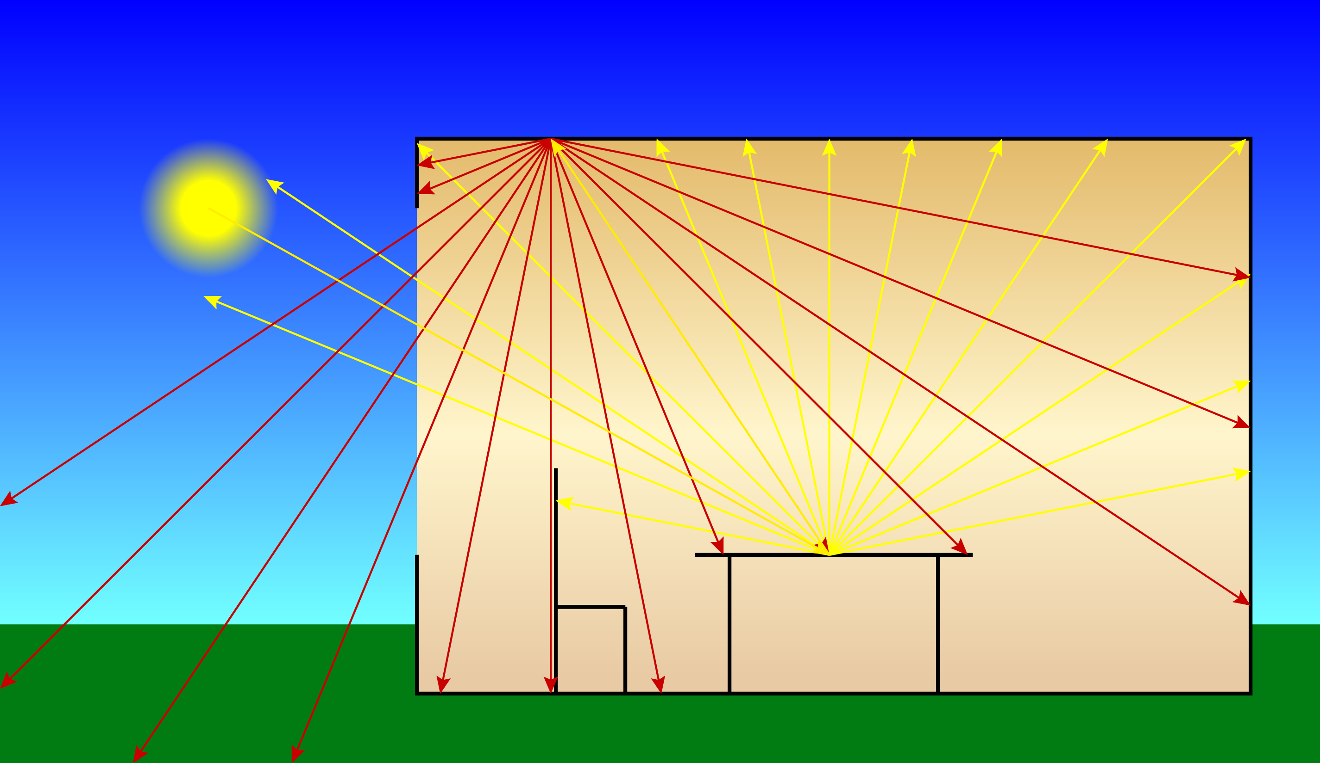
… of the surfaces in the scene.

Slide 10
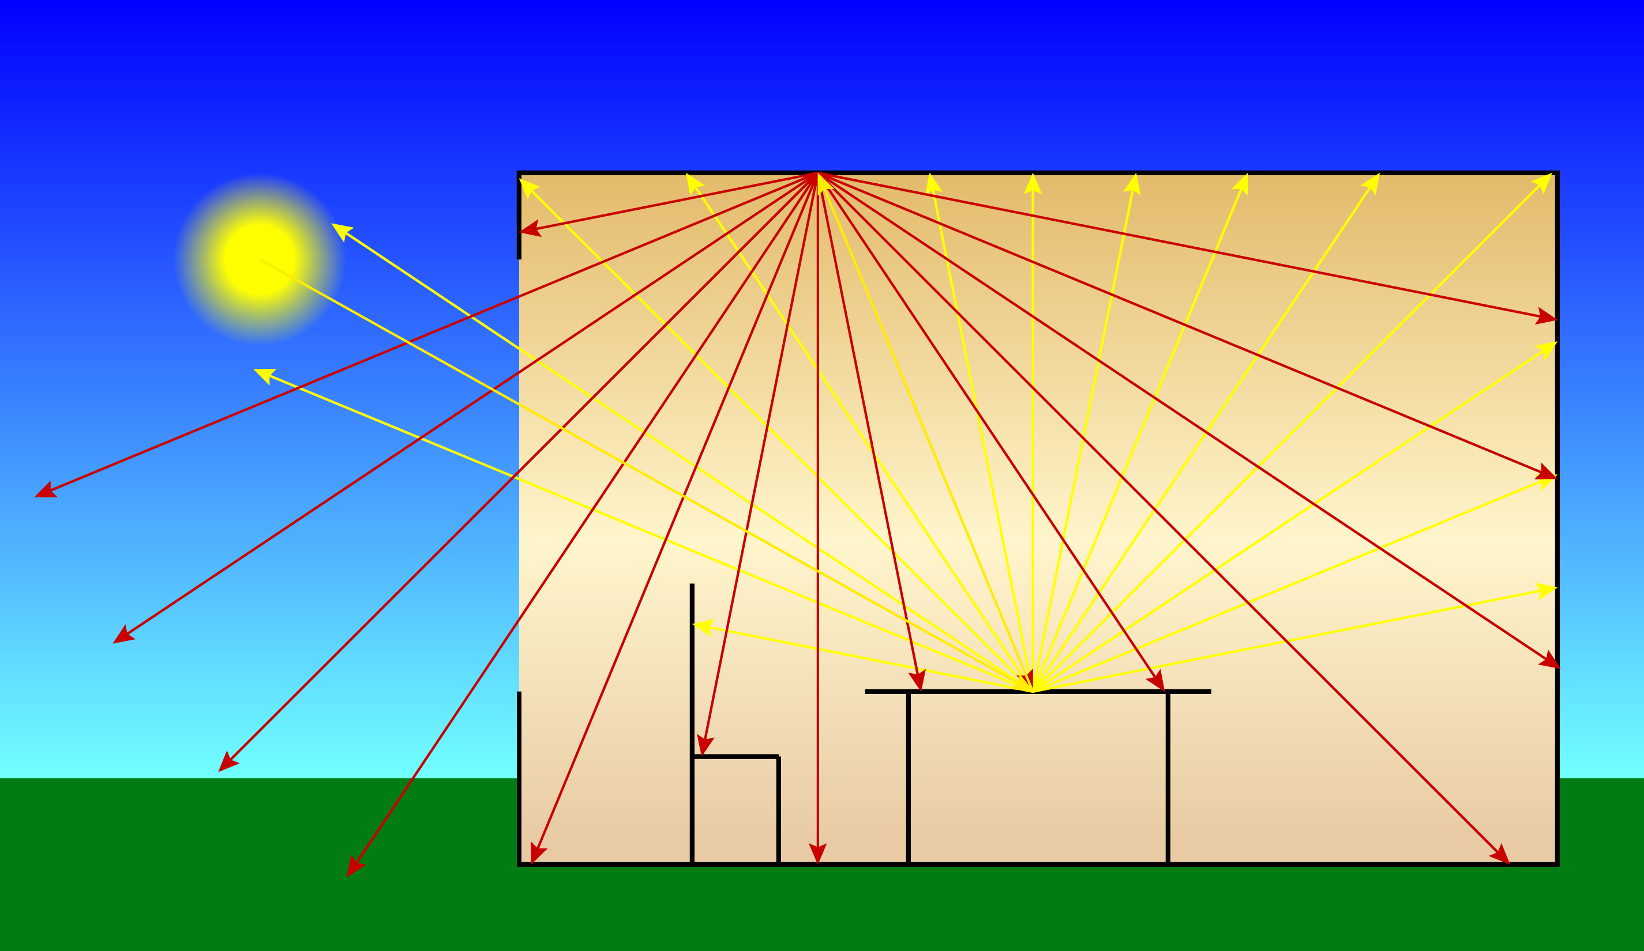
Materials are transparent …

Slide 11

… to some wavelengths …

Slide 12
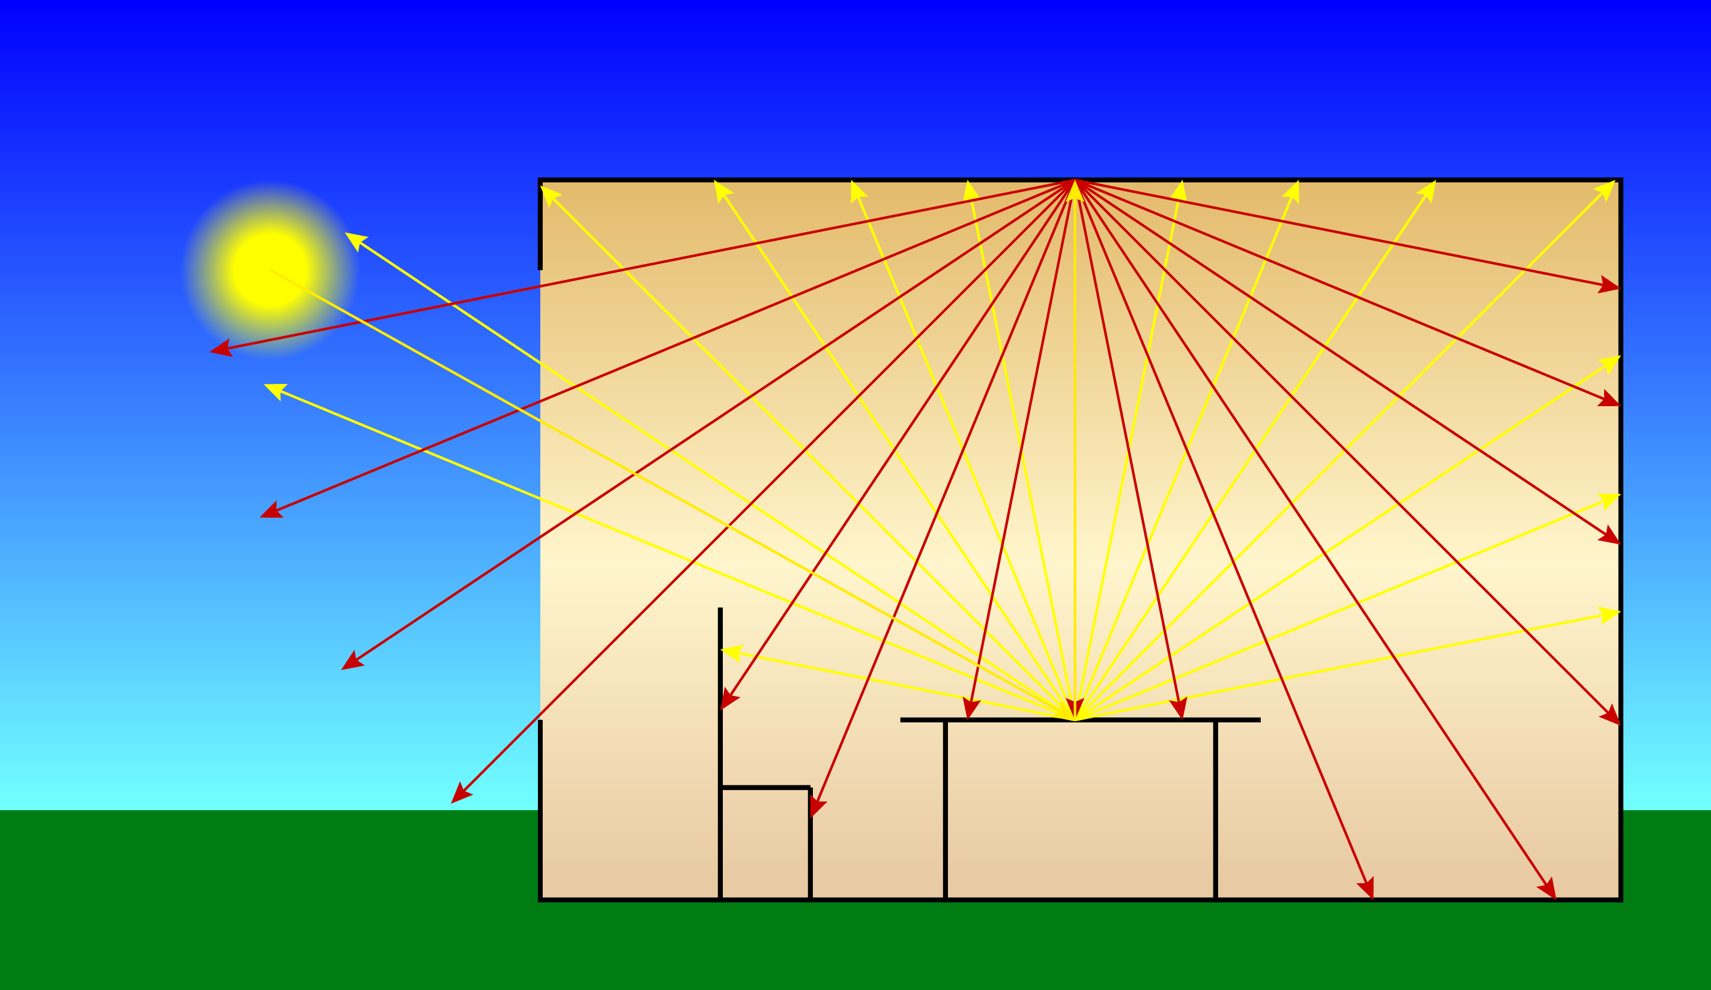
… opaque to others …

Slide 13
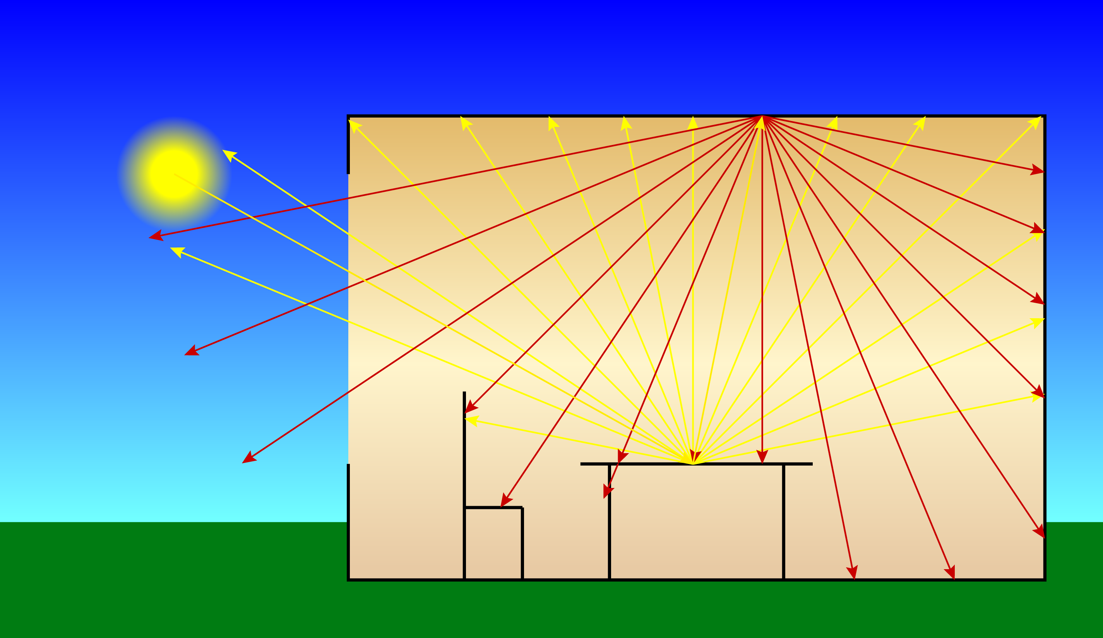
… and reflect yet other wavelengths.

Slide 14
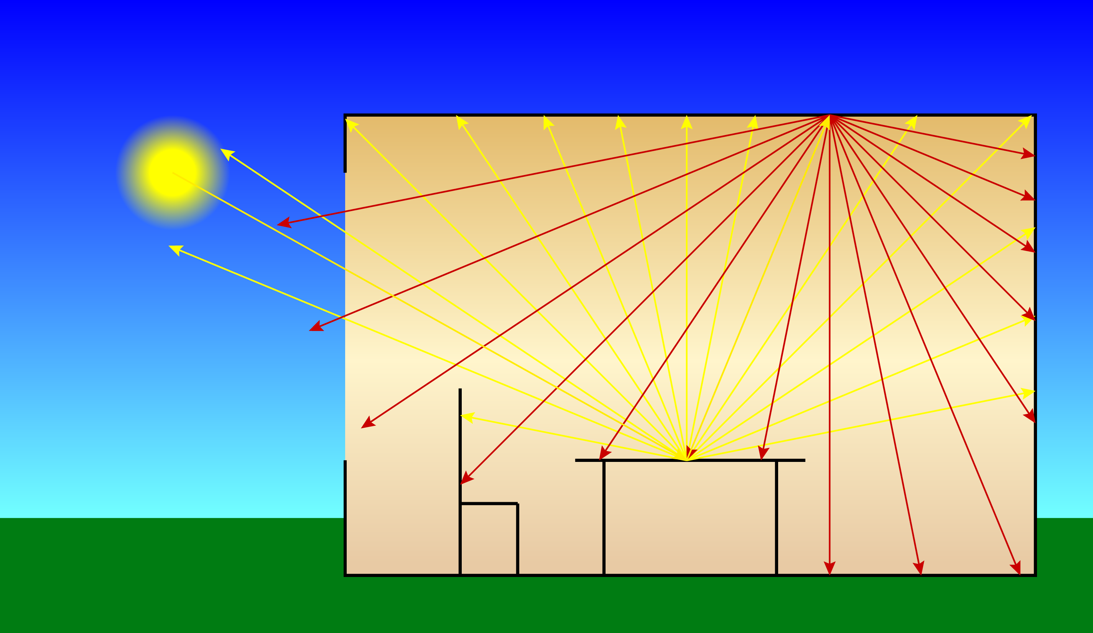
Smooth surfaces may be mirror-like, …

Slide 15
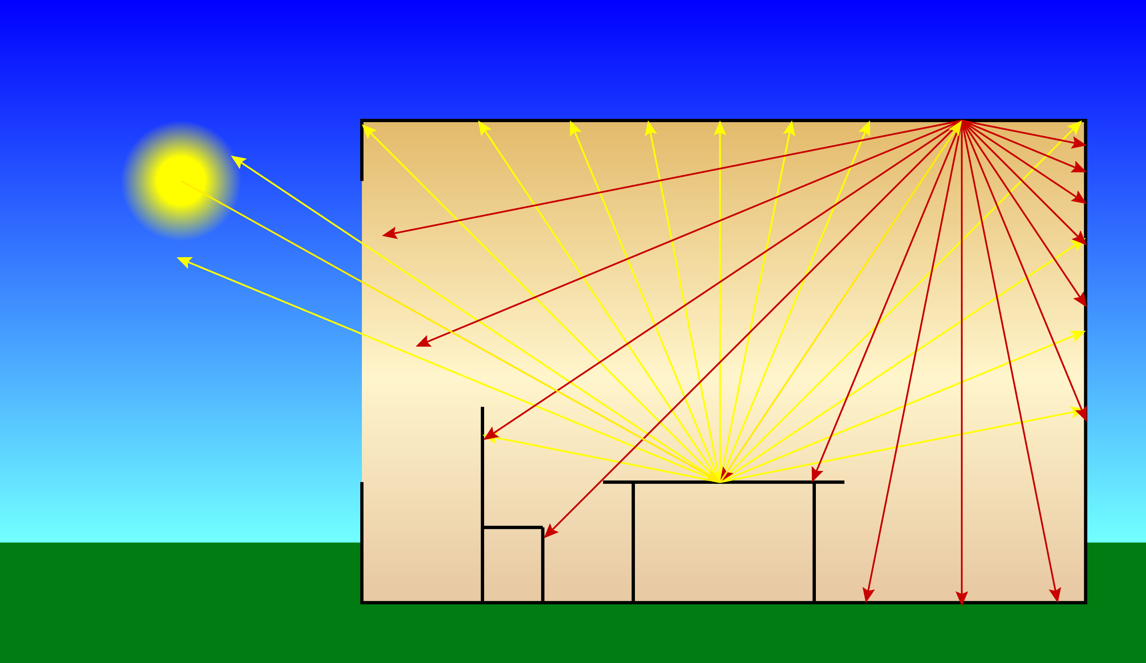
…rough surfaces, matte or diffuse.

Slide 16
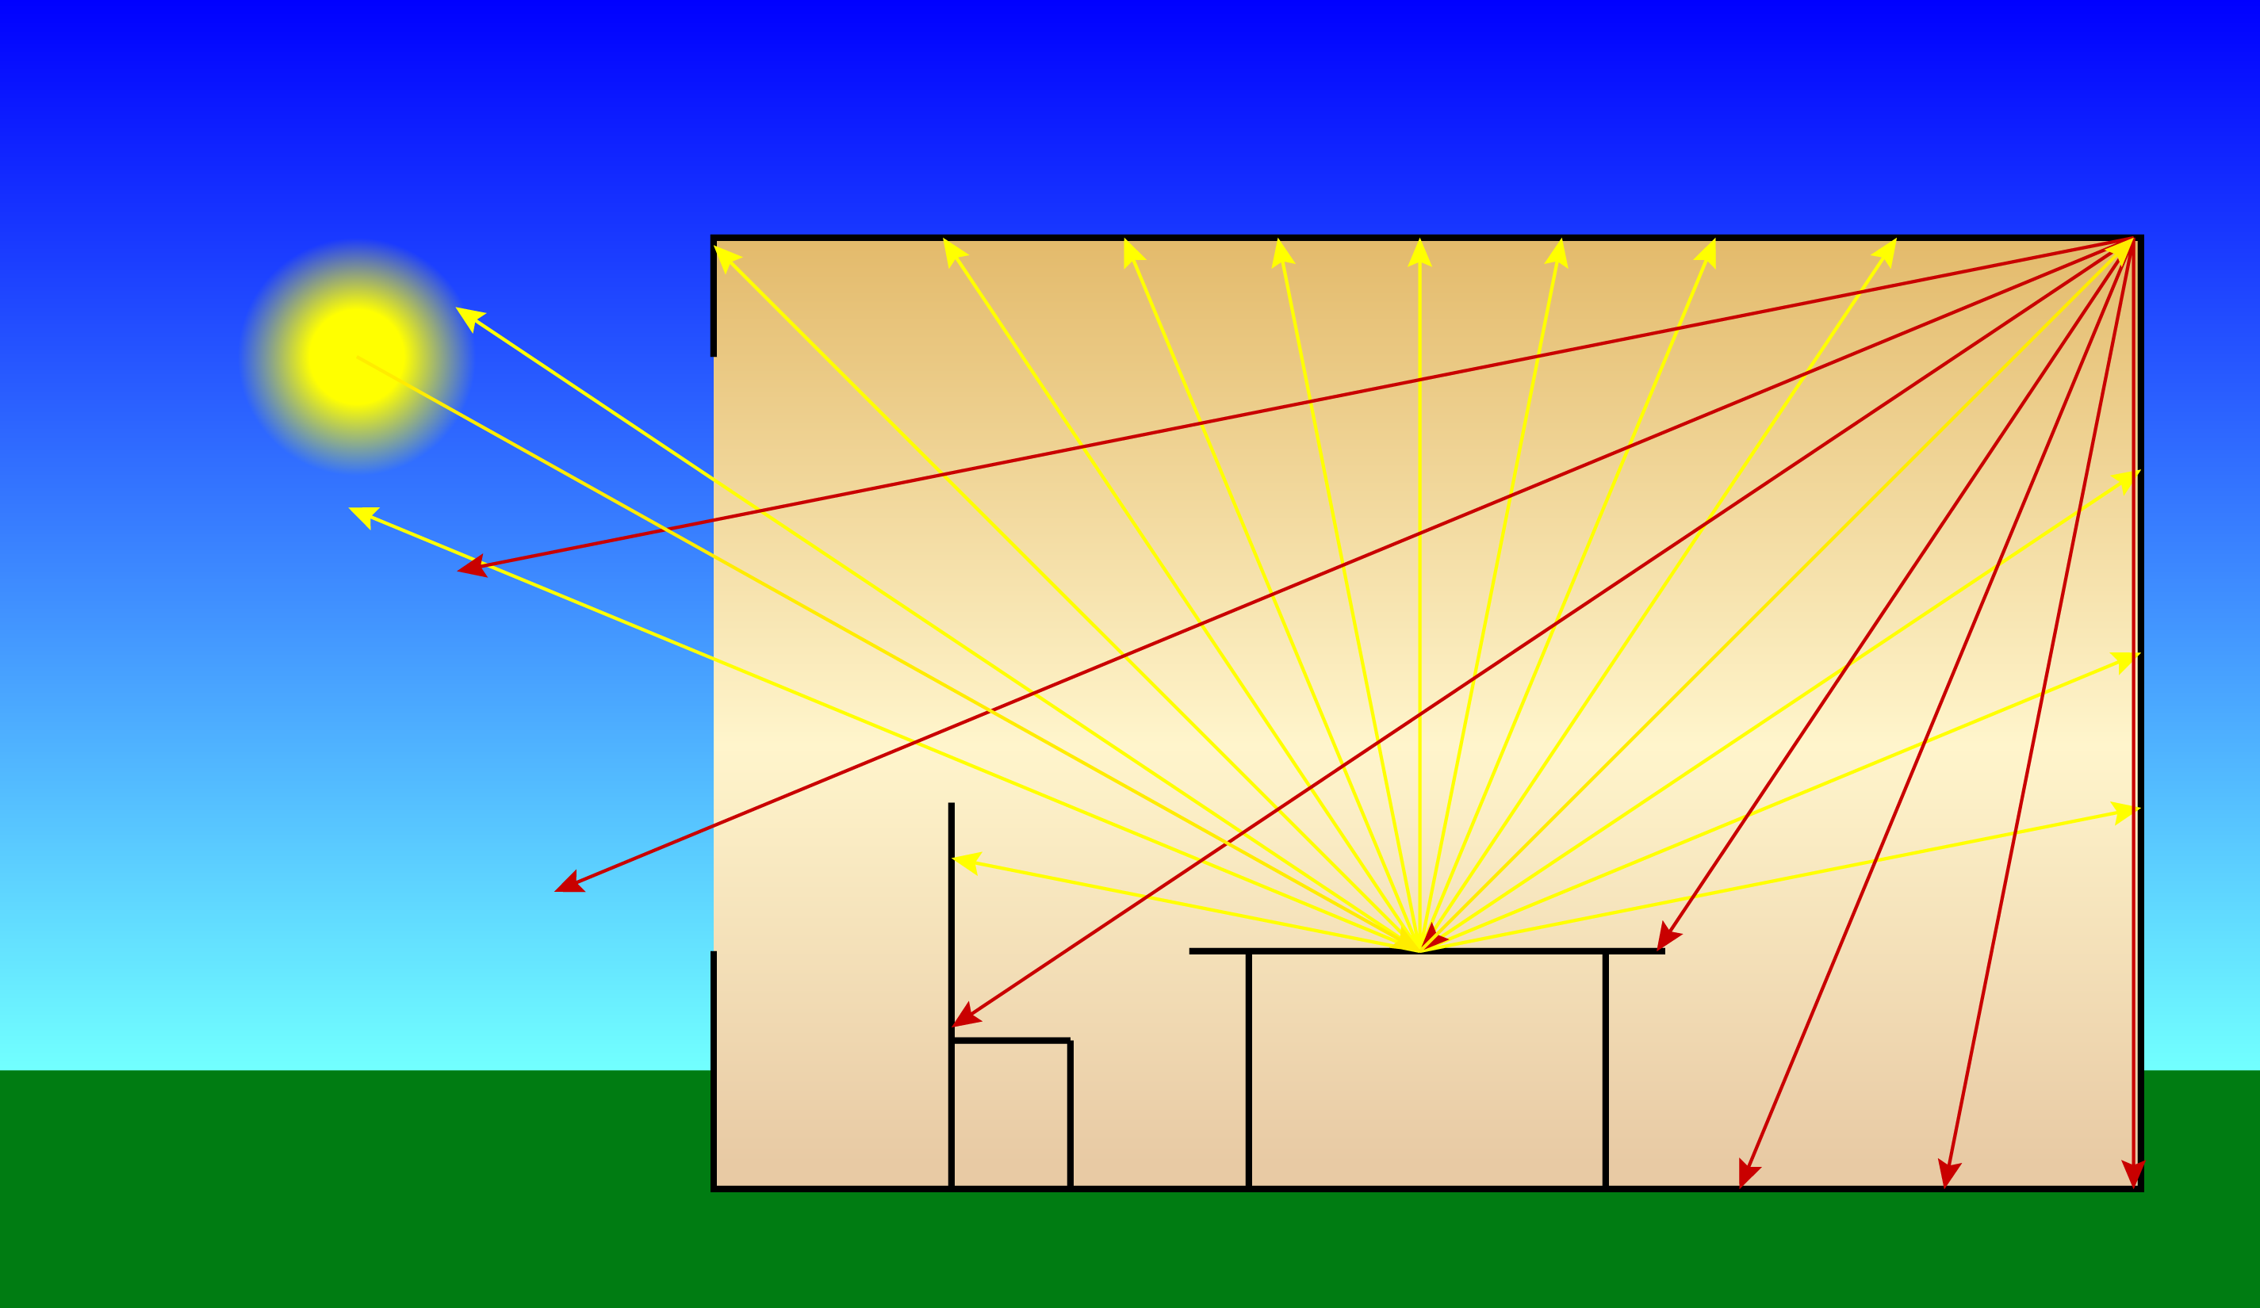
Anisotropic surfaces scatter more in …

Slide 17

… in one direction than others.

Slide 18
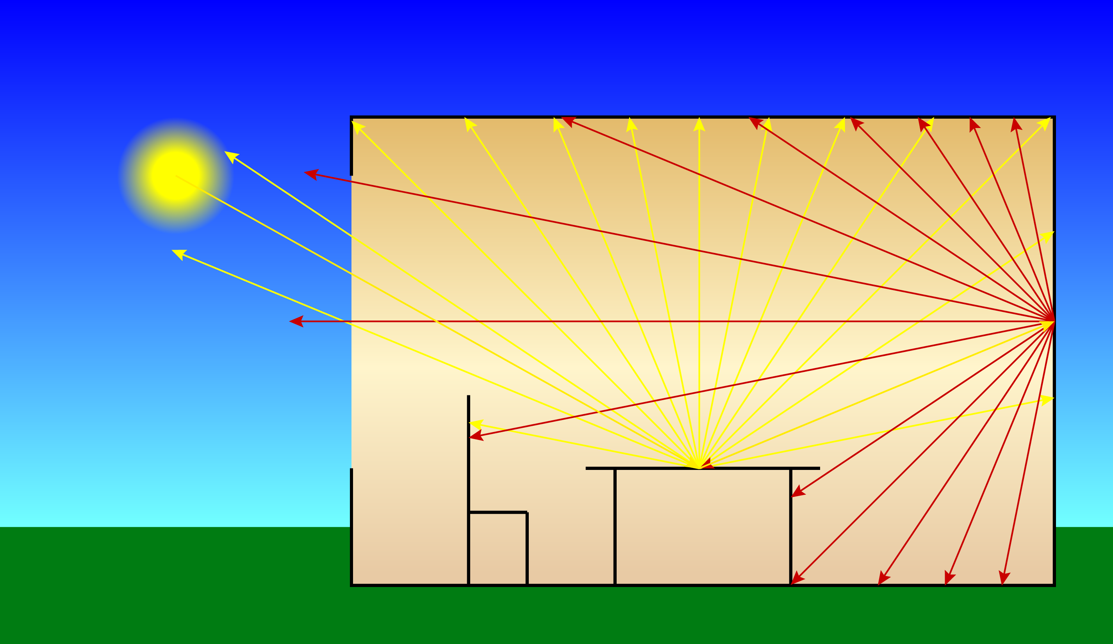
The color of a surface affects those …

Slide 19
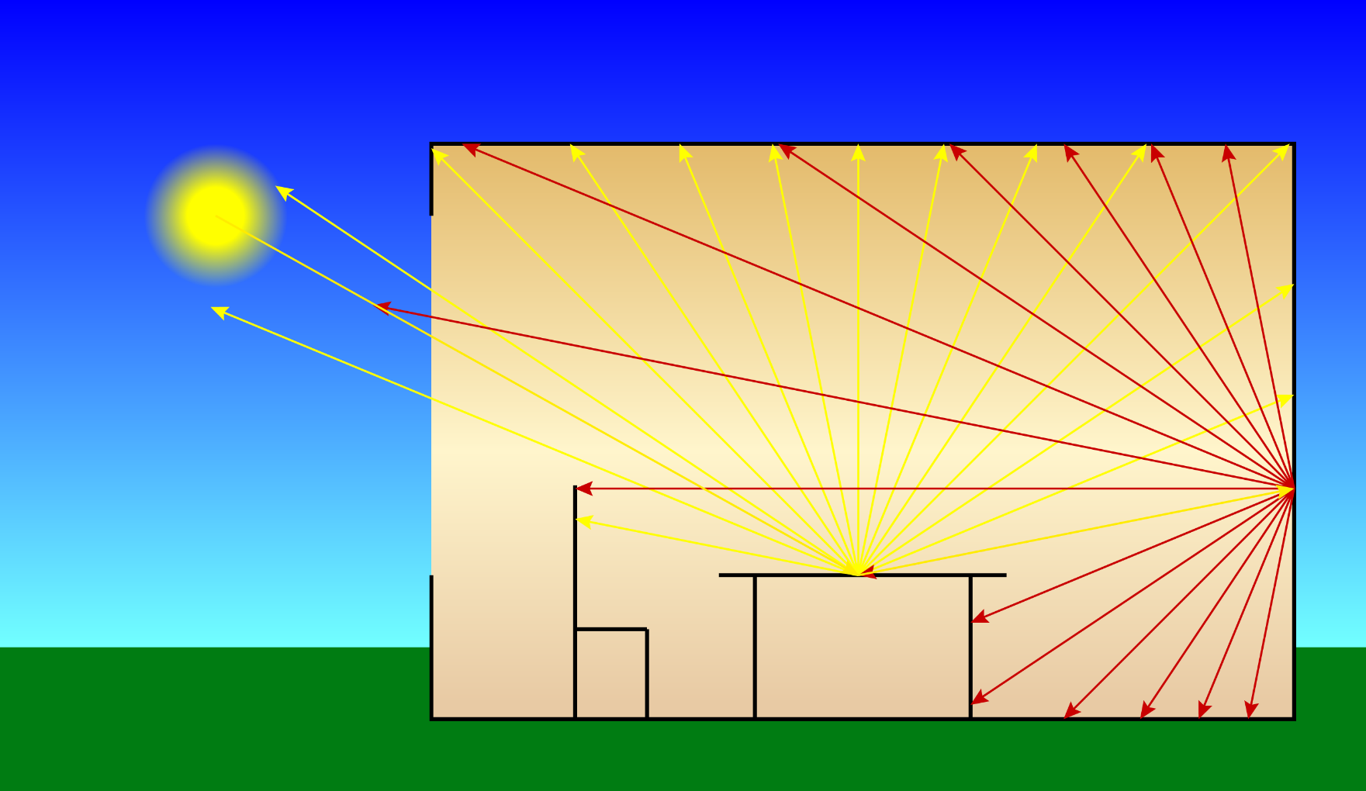
… of nearby surfaces. The result …

Slide 20
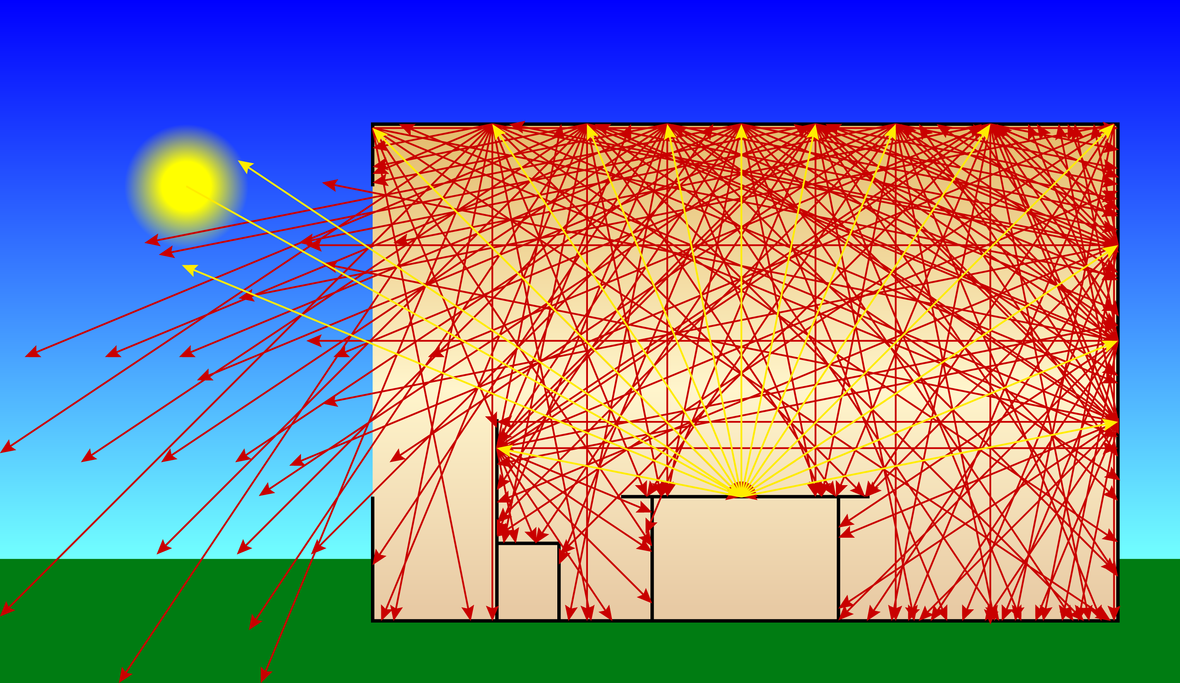
… is highly complex.
The Plenoptic Function

Slide 21
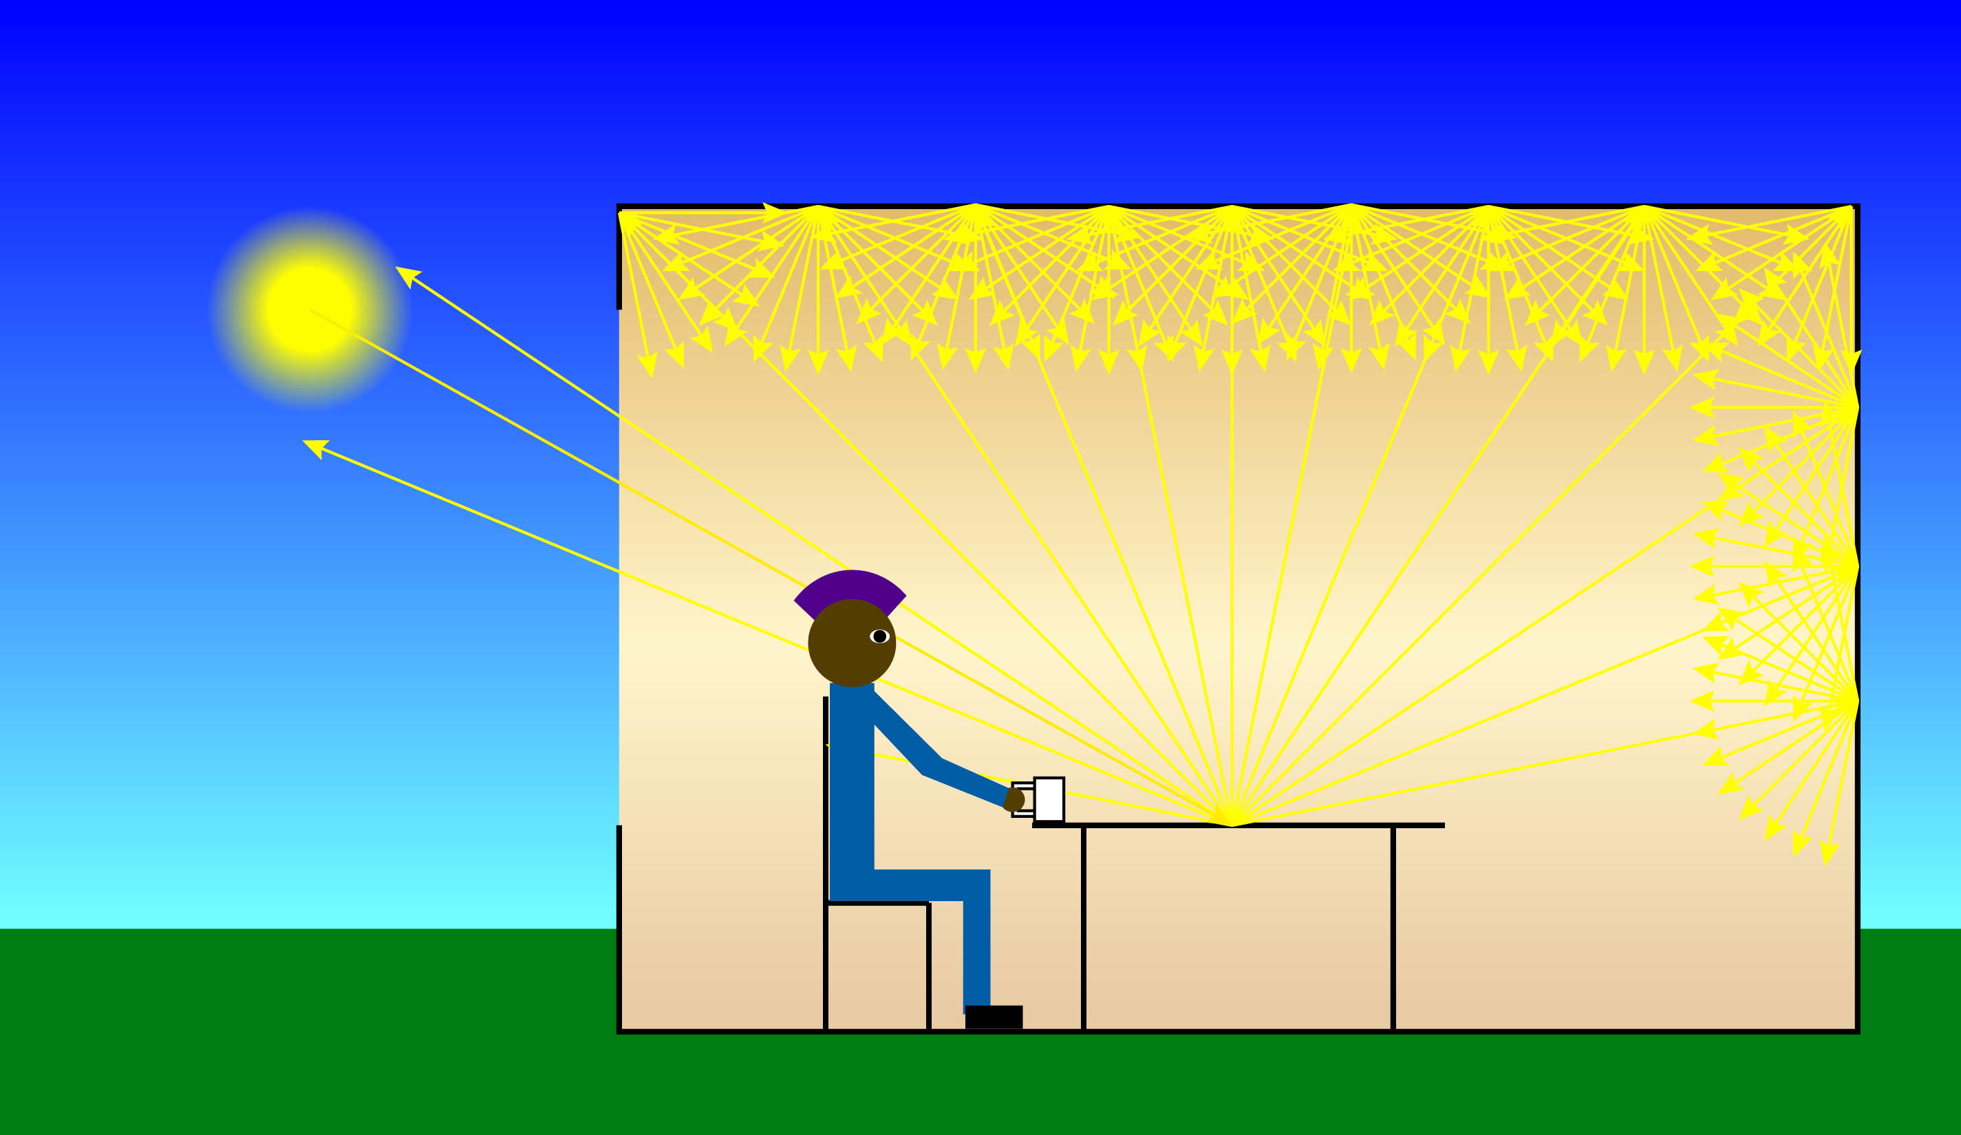
An observer, awash in all the light, …

Slide 22

... sees the result of both illumination …

Slide 23
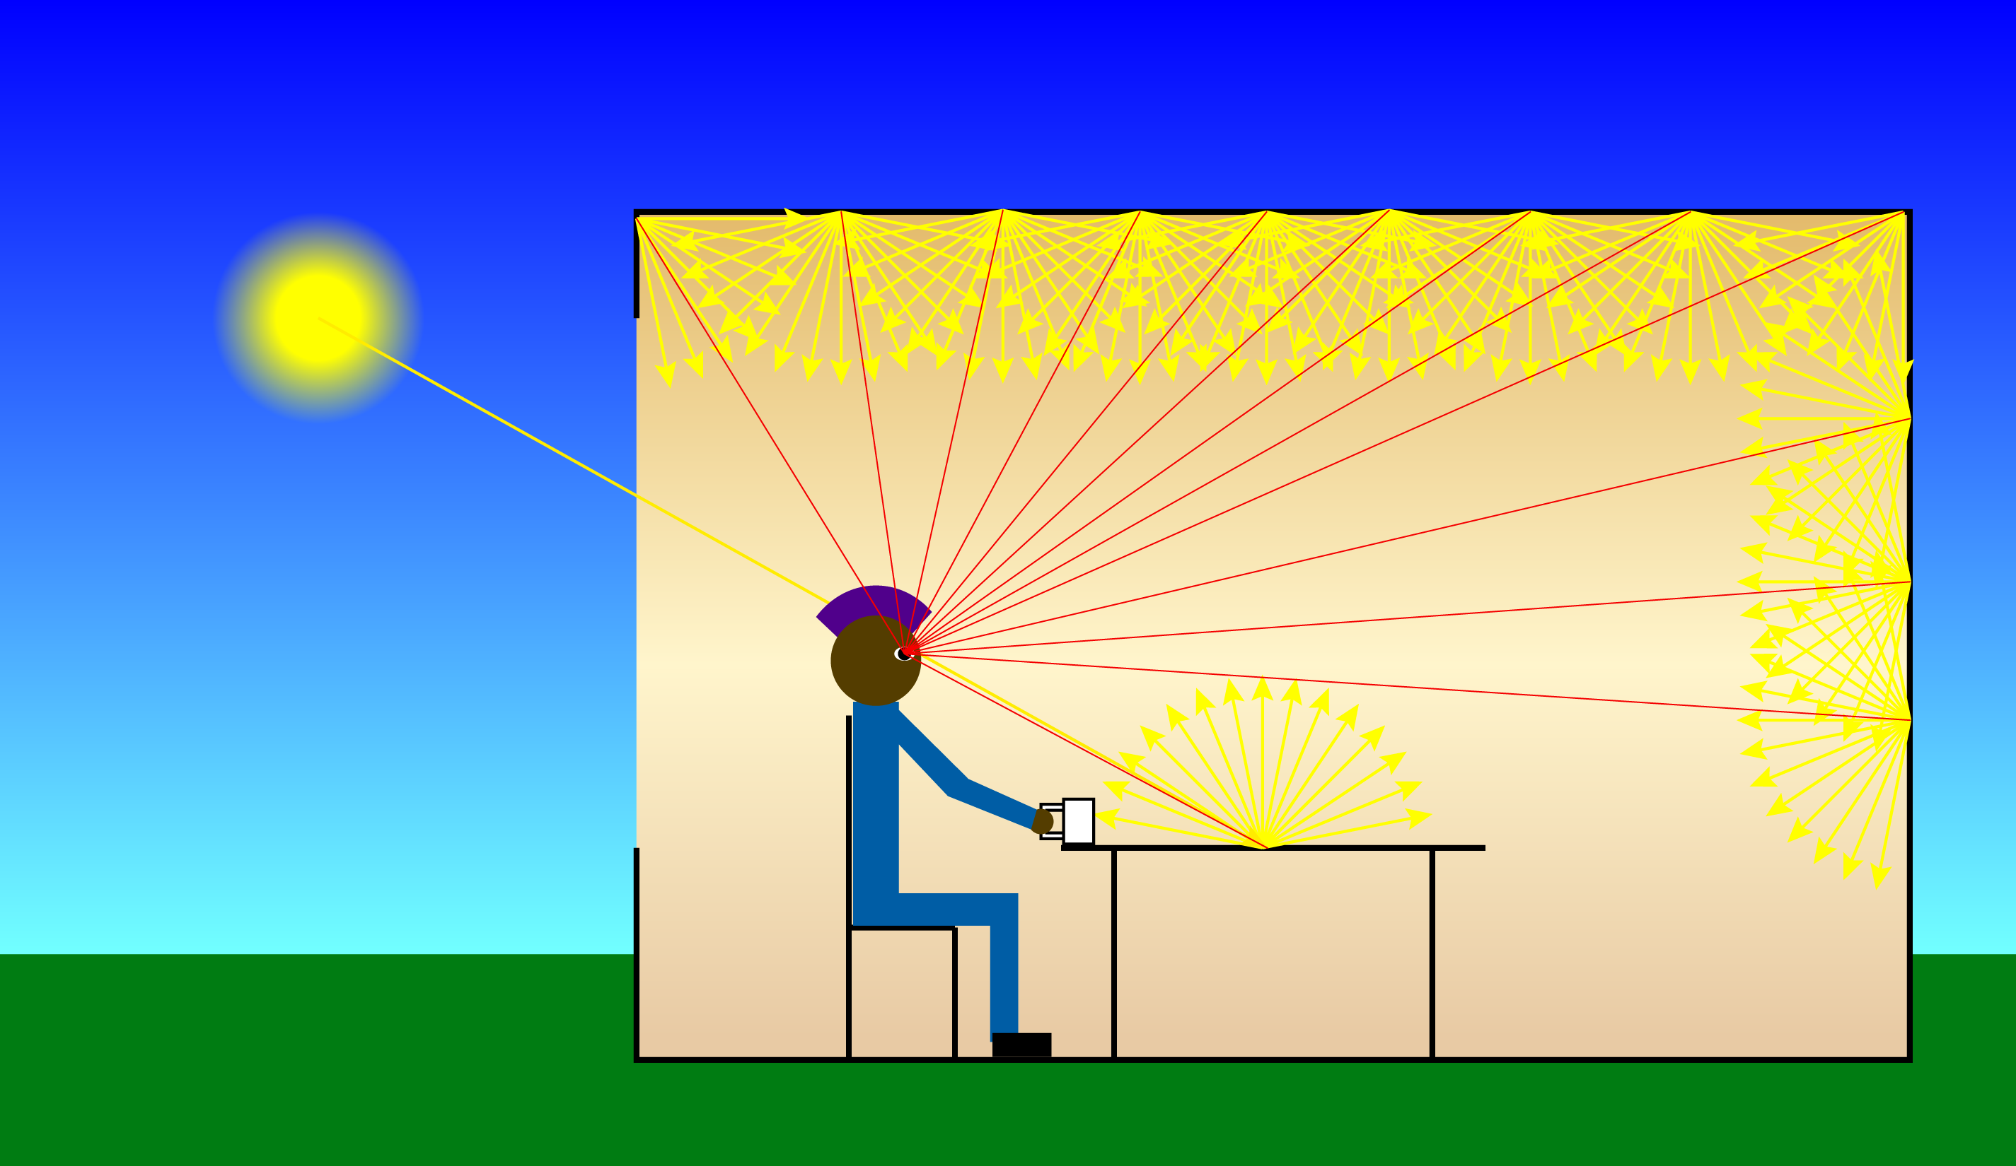
… and surface interreflection.

Slide 24
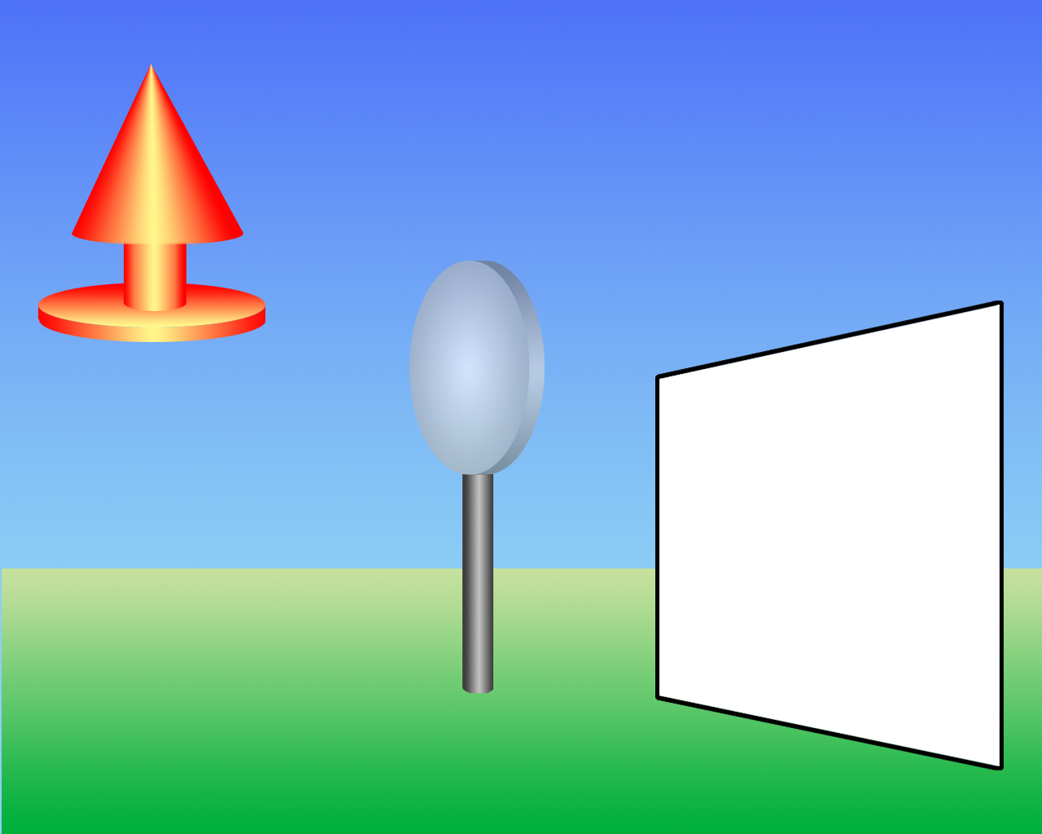
lens
Image Formation
object
image plane

Slide 25
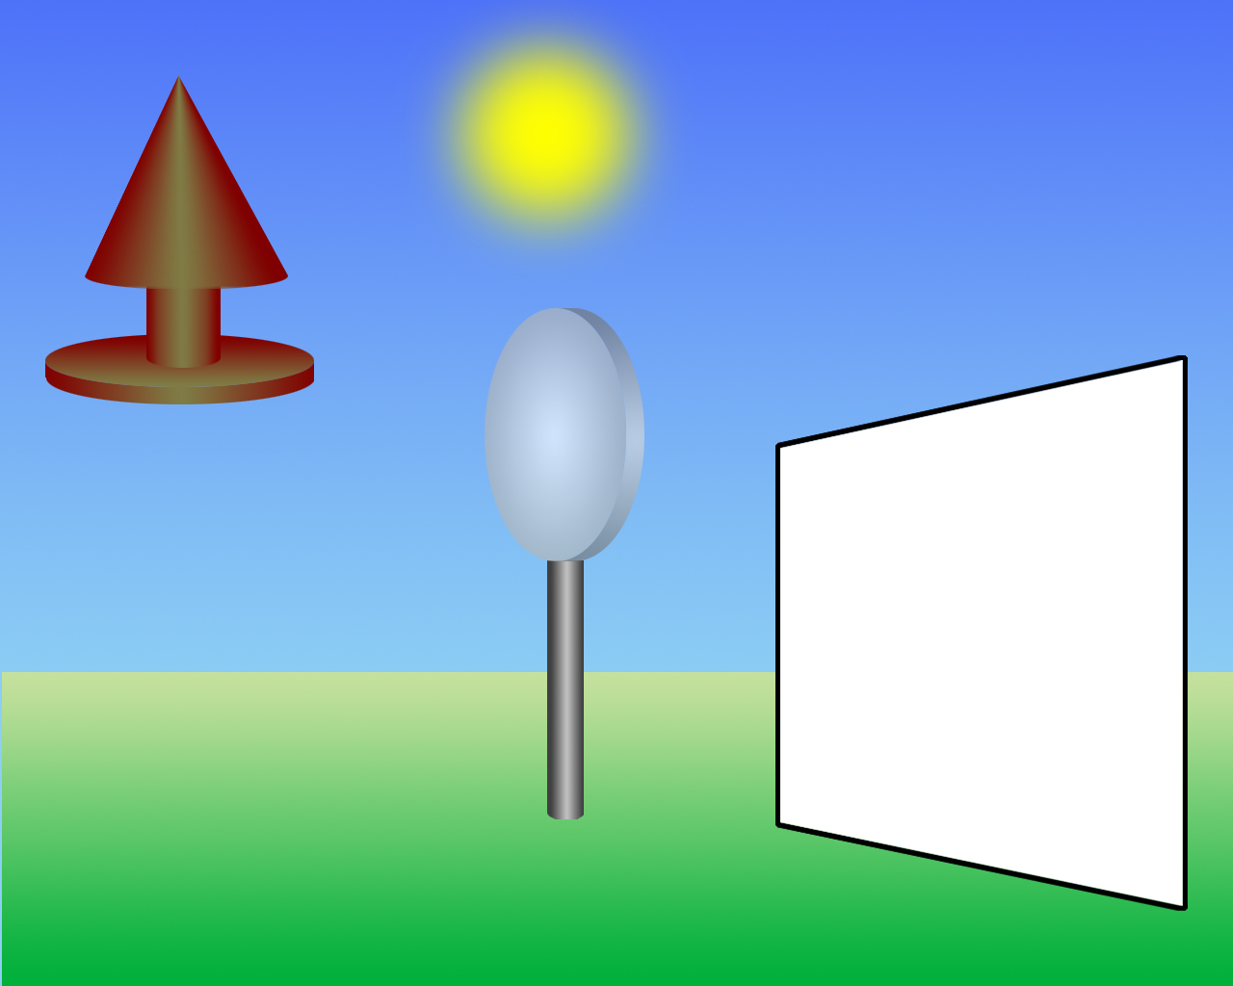
Image Formation
light source

Slide 26
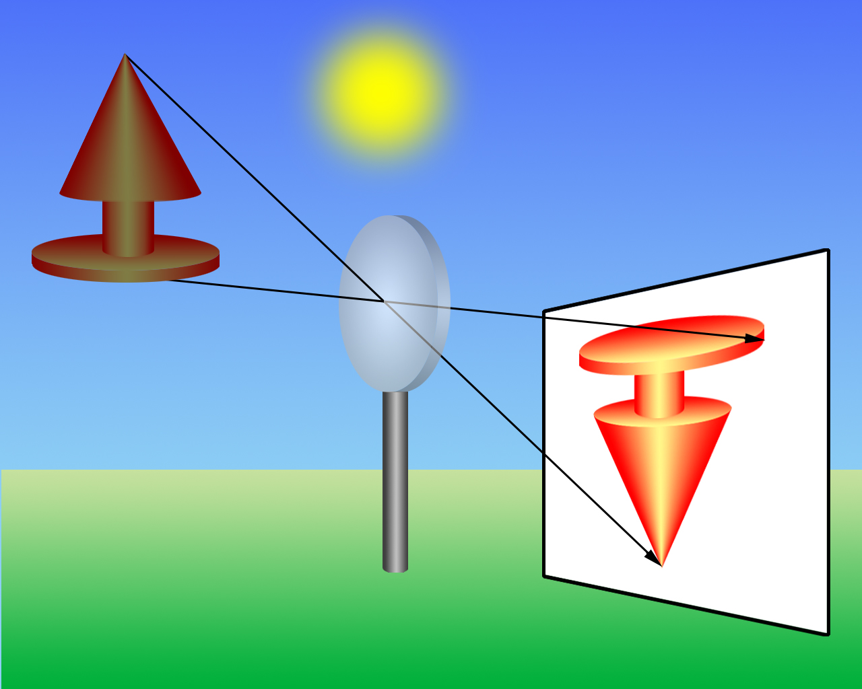
Image Formation
projection
through lens
image of object

Slide 27
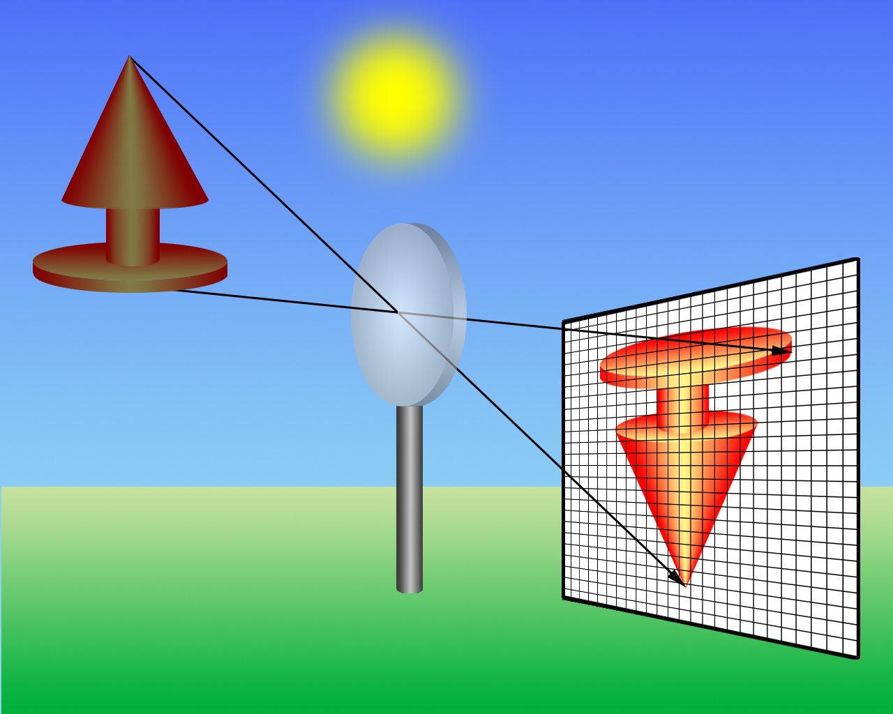
Image Formation
projection onto discrete sensor array.
digital camera

Slide 28

Image Formation
sensors register average color.
sampled image

Slide 29

Image Formation
continuous colors, discrete locations.
discrete real-valued image

Slide 30

Sampling and Quantization
real image
sampled
quantized
sampled & quantized

Slide 31
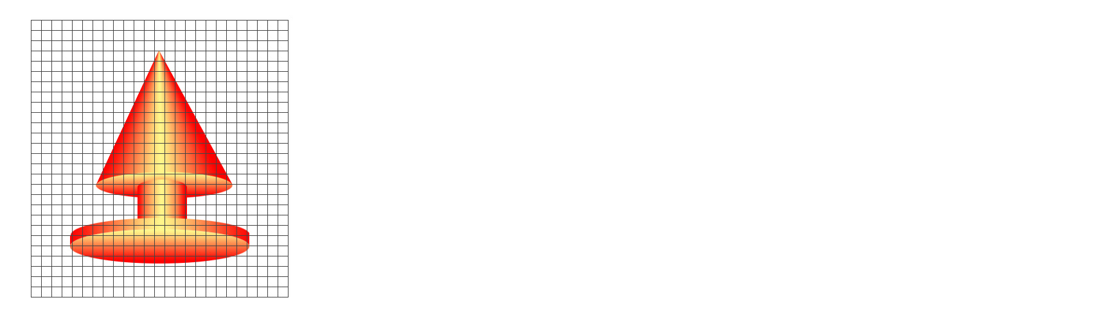
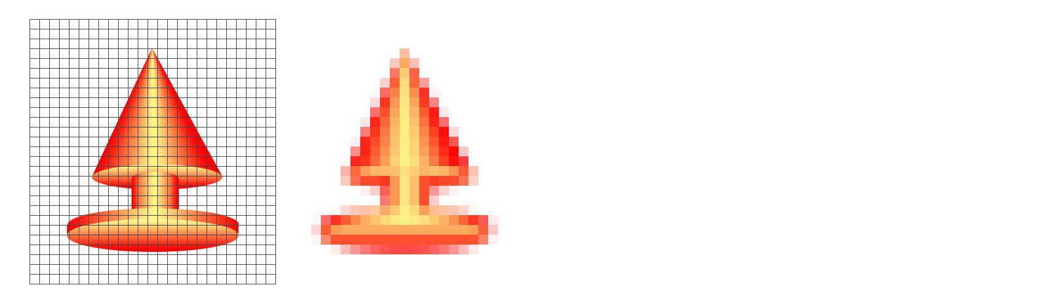
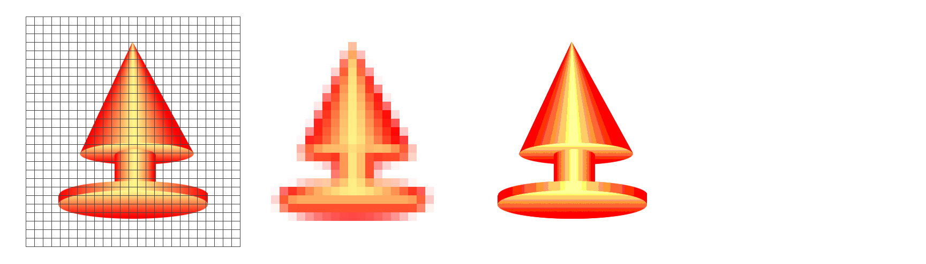
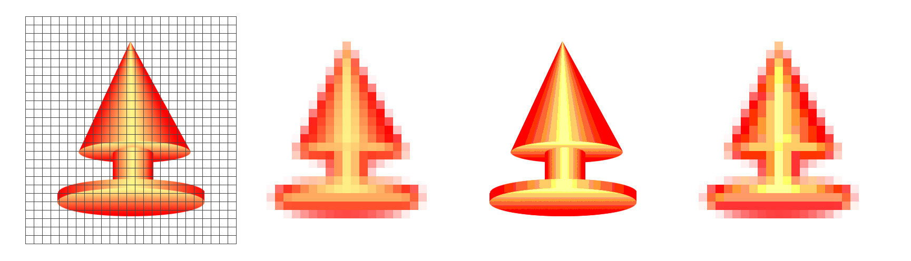
Sampling and Quantization
pixel grid
column index
row index
real image
sampled
quantized
sampled & quantized

Slide 32
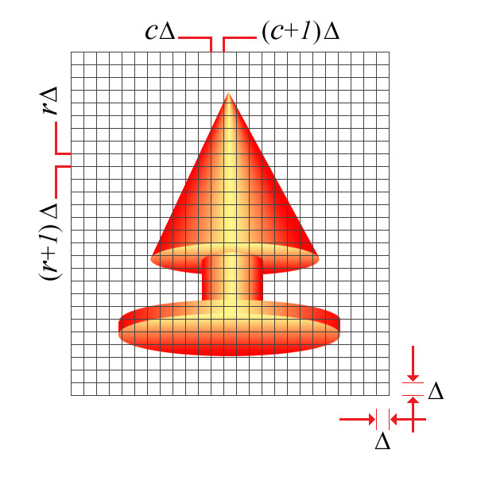
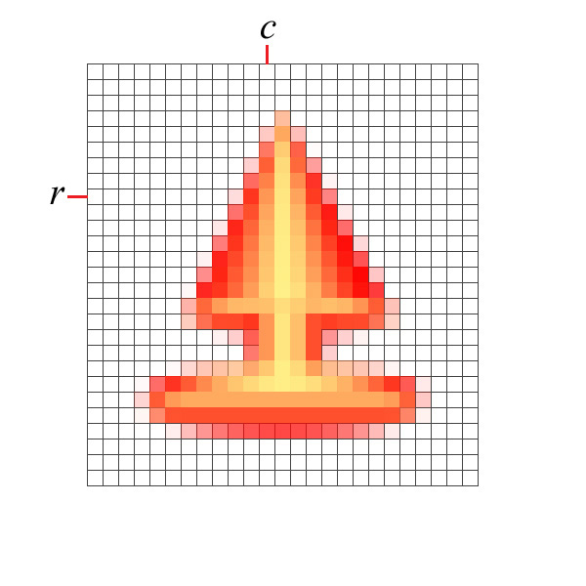


Sampling
Take the average within each square.
continuous image
sampled image

Slide 33
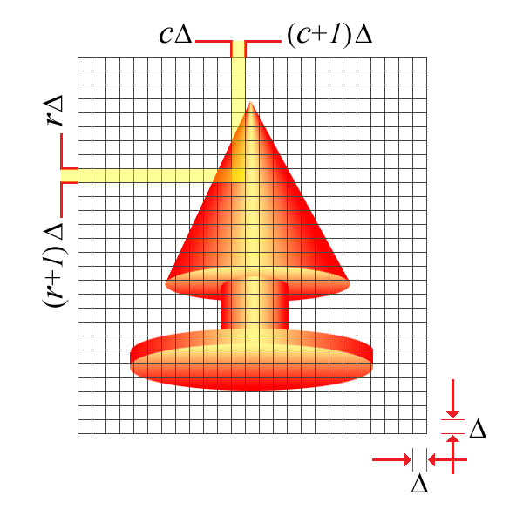
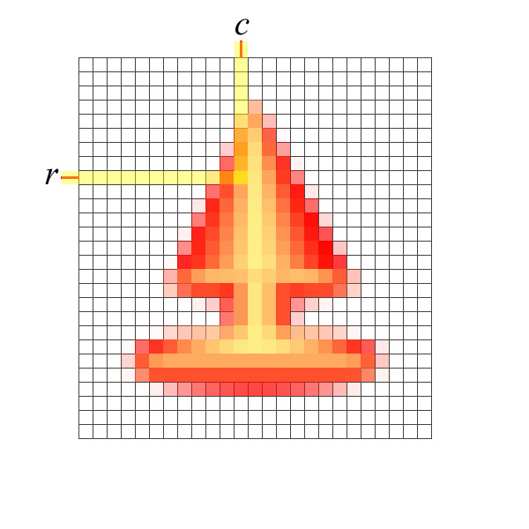
Sampling
Take the average within each square.
continuous image
sampled image

Slide 34
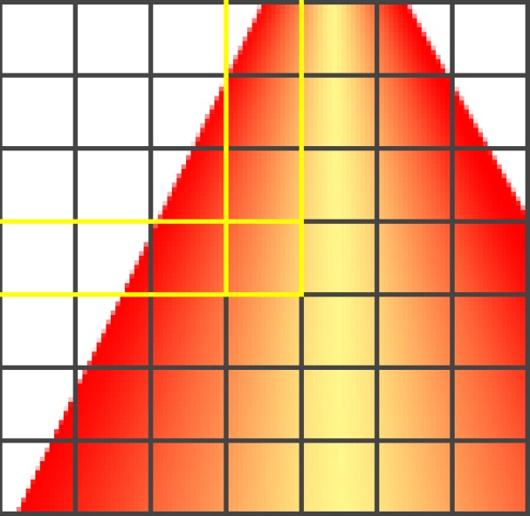
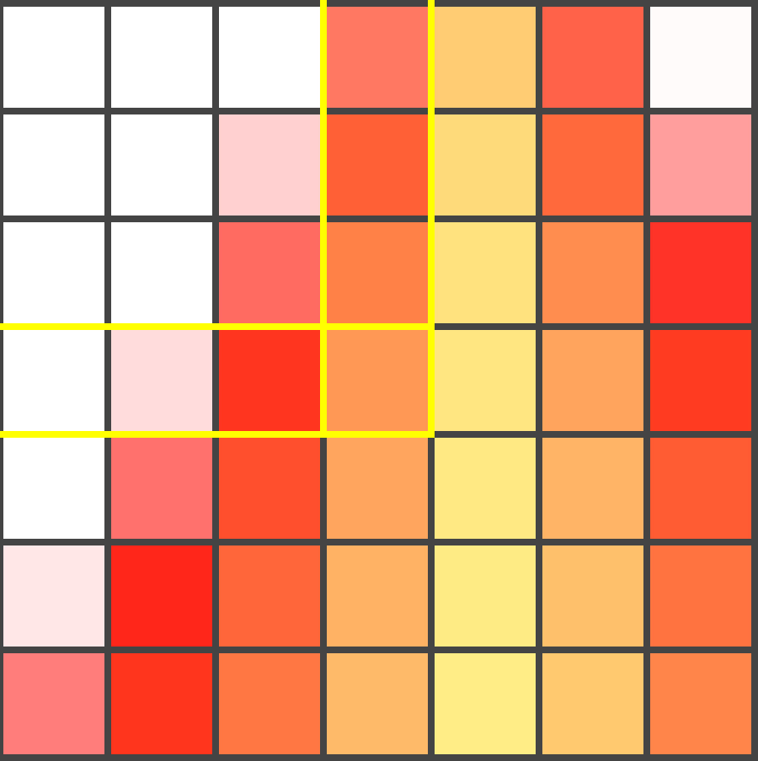
Sampling
Take the average within each square.
continuous image
sampled image

Slide 35
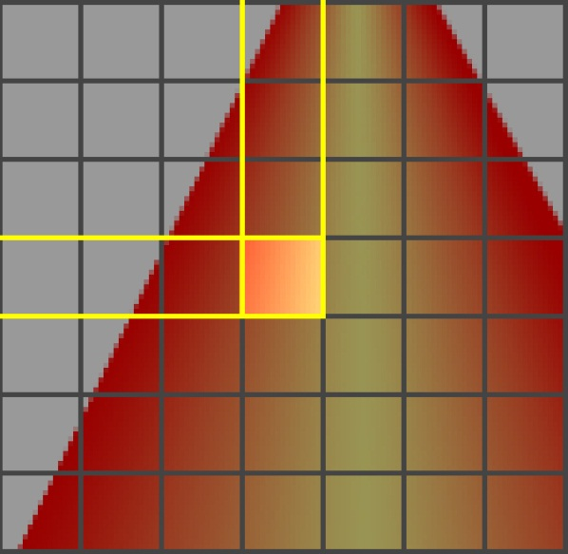
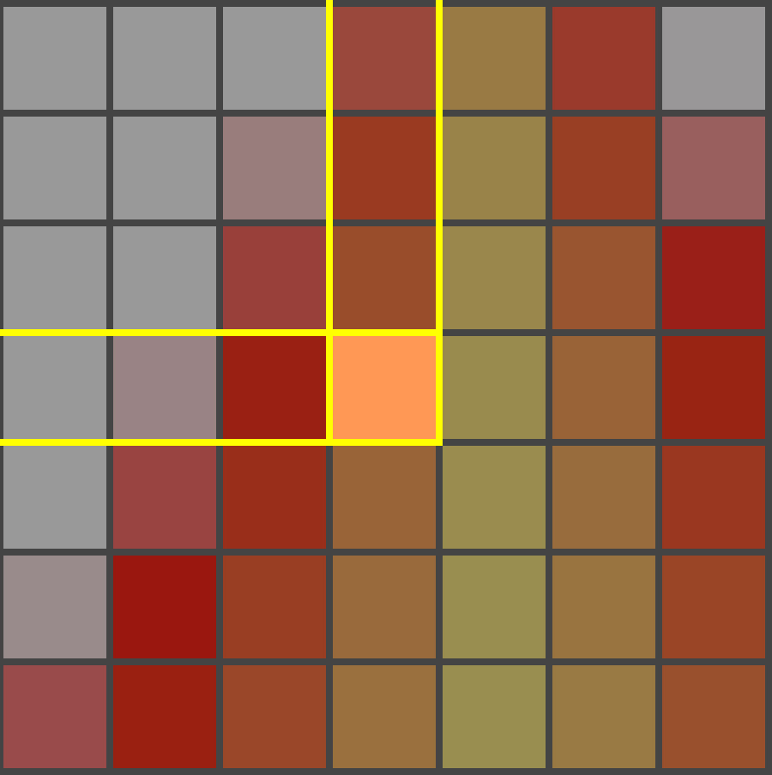
Sampling
Take the average within each square.
continuous image
sampled image

Slide 36
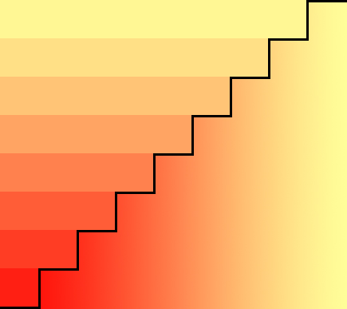
Digital Image Formation: Quantization
discrete color output
continuous colors mapped to a finite, discrete set of colors.
continuous color input

Slide 37
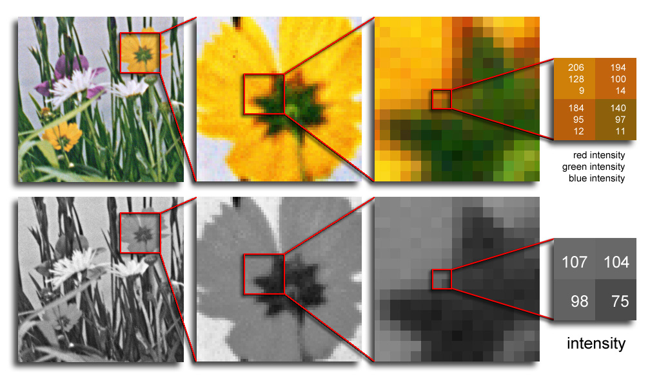
Digital Image
Color images have 3 values per pixel; monochrome images have 1 value per pixel.
a grid of squares, each of which contains a single color
each square is called a pixel (for picture element)

Slide 38
Pixels
A digital image, I, is a mapping from a 2D grid of uniformly spaced discrete points, {p = (r,c)}, into a set of positive integer values, {I( p)}, or a set of vector values, e.g., {[R G B]^{T}( p)}.
At each column location in each row of I there is a value.
The pair ( p, I( p) ) is called a “pixel” (for picture element).

Slide 39
Pixels
p = (r,c) is the pixel location indexed by row, r, and column, c.
I( p) = I(r,c) is the value of the pixel at location p.
If I( p) is a single number then I is monochrome.
If I( p) is a vector (ordered list of numbers) then I has multiple bands (e.g., a color image).

Slide 40
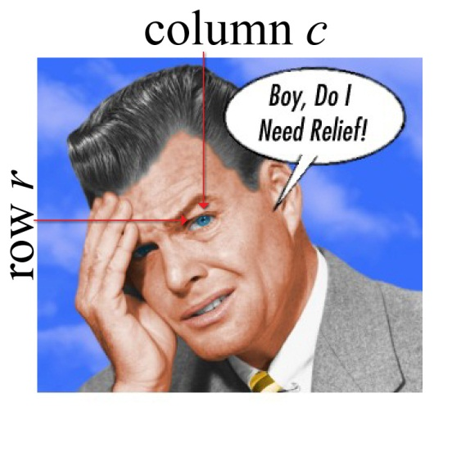
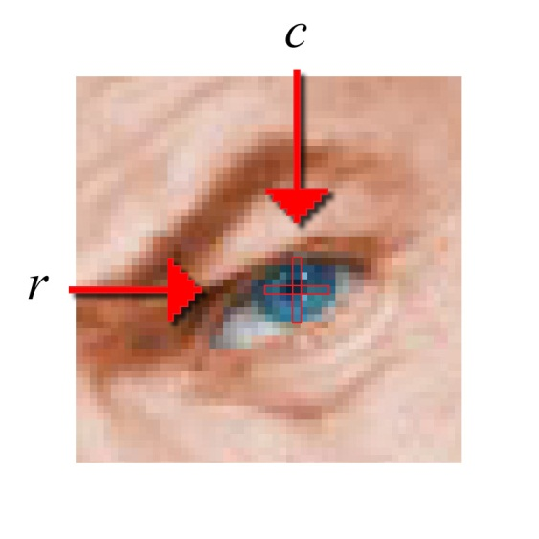
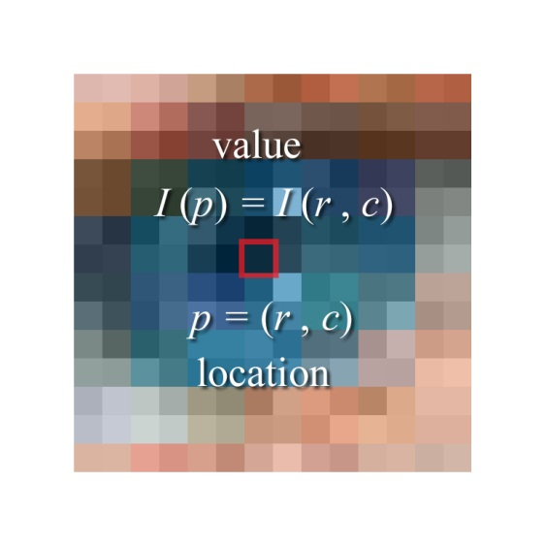
Pixels
Pixel Location: p = (r , c)
Pixel Value: I(p) = I(r , c)
Pixel : [ p, I(p)]

Slide 41
Pixels
Pixel : [ p, I(p)]

Slide 42
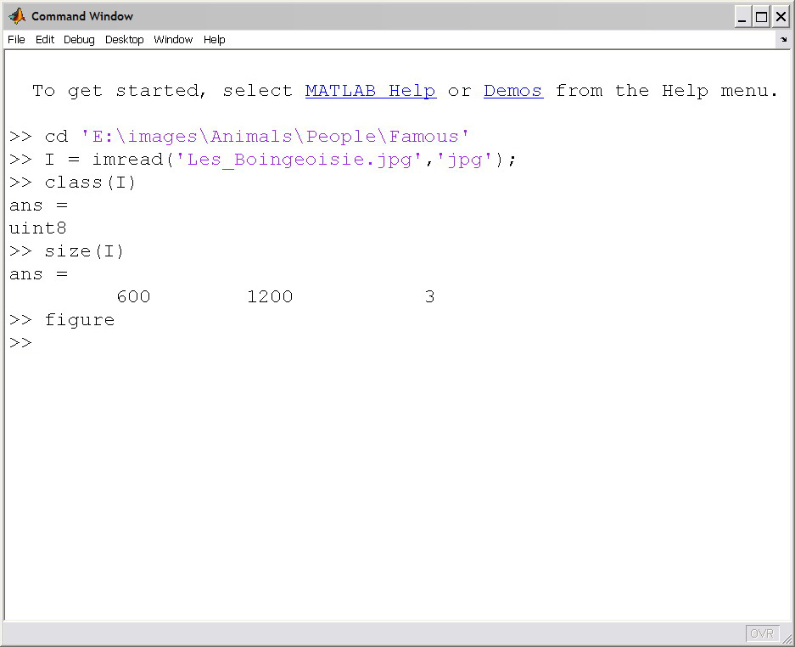
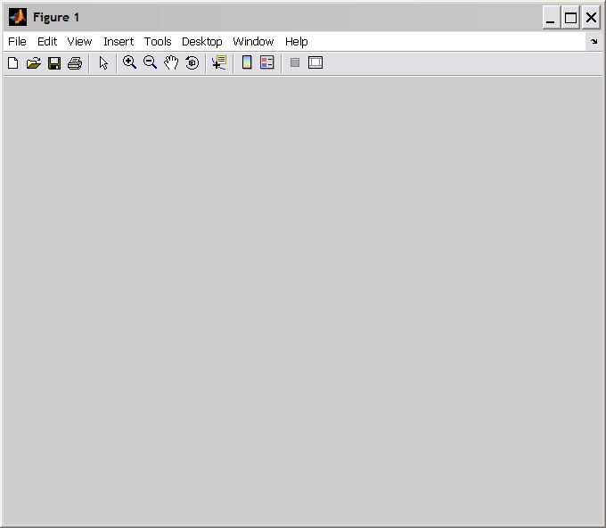
Read a Truecolor Image into Matlab
The next few slides demonstrate the results of the commands shown in the command window. Each successive slide starts at the end of the previous one.
First, change to the directory that holds the image.
Then load the image into an a matrix labeled ‘I’. (It could be any valid Matlab name.)
Display the image’s dimensions using the size() command.
Then, create a figure window.

Slide 43
Read a Truecolor Image into Matlab
On the class() command:
If X is a matrix of 64-bit floating-point numbers (Matlab’s default data class) class(X) returns ‘double’ (without the quotes).
If X is a matrix of 8-bit unsigned integers (like most common images) class(X) returns ‘uint8’).
Matlab has other data classes, too. Search for ‘Fundamental MATLAB Classes’ in the help window for a description of them.
Related to the size() command: length(X)
returns the size of the largest dimension of X.
length(X(:)) returns the number of elements in X.
On the size() command:
If X is a scalar size(X) returns 1 1
If X is a 1-D row vector w/ 5 entries, it returns 1 5
If X is a 1-D column vec w/ 5 entries, it returns 5 1
If X is a 4-row by 5-column matrix, it returns 4 5
If X is an R-row by C-column, 1-band image, it returns R C
If X is an R-row by C-column, 3-band image, it returns R C 3
E.g. Above, I is a 600-row by 1200-column by 3-band image.

Slide 44
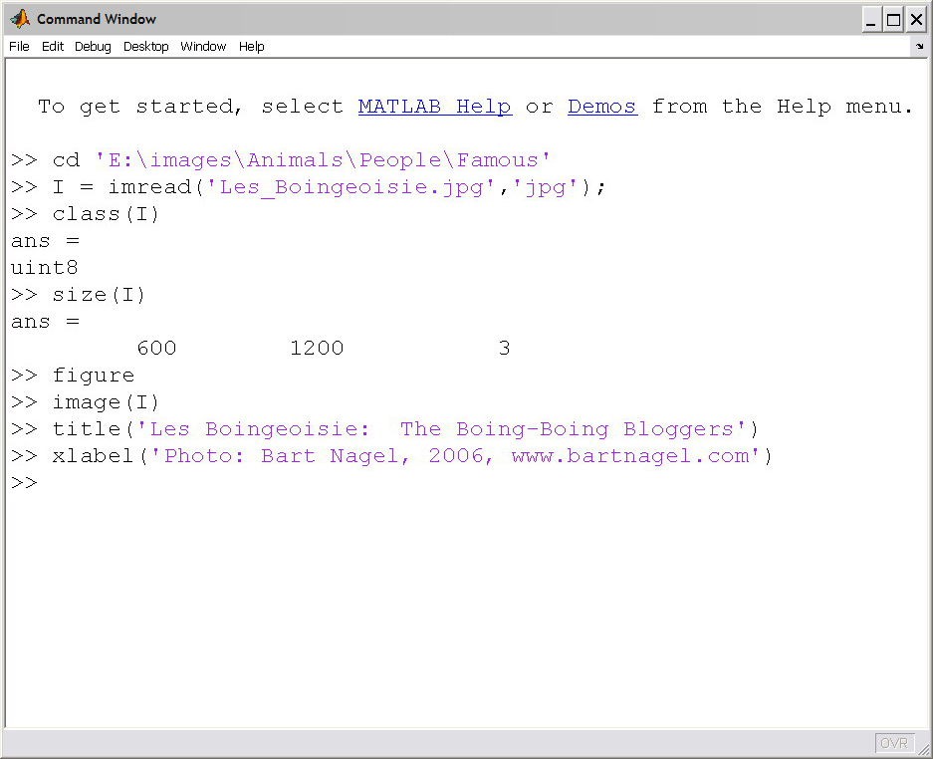
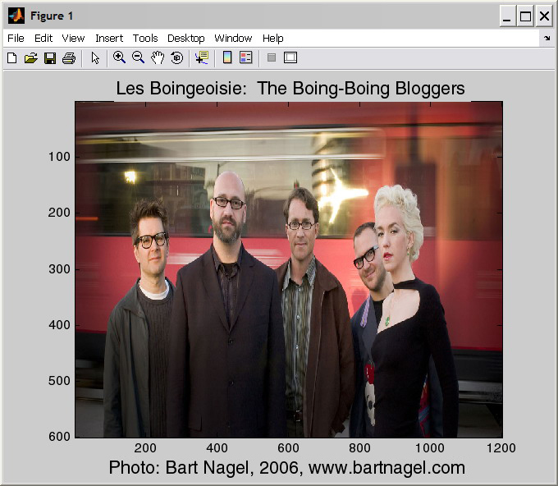
Read a Truecolor Image into Matlab
Matlab scales the image to fit the figure window so both the images size and aspect ratio are usually incorrect.
Display the image in the figure window using image().
Place a title at the top.
Put a label under the x-axis using xlabel().
ylabel() puts a label to the left of the y-axis, oriented 90° from horizontal

Slide 45
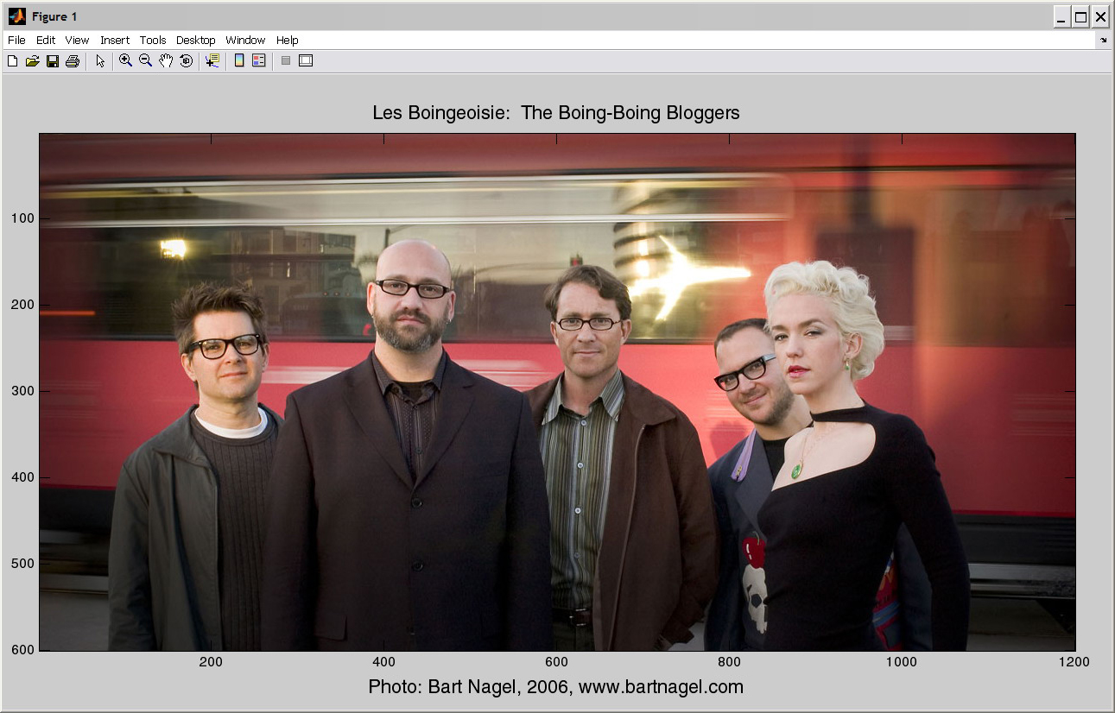
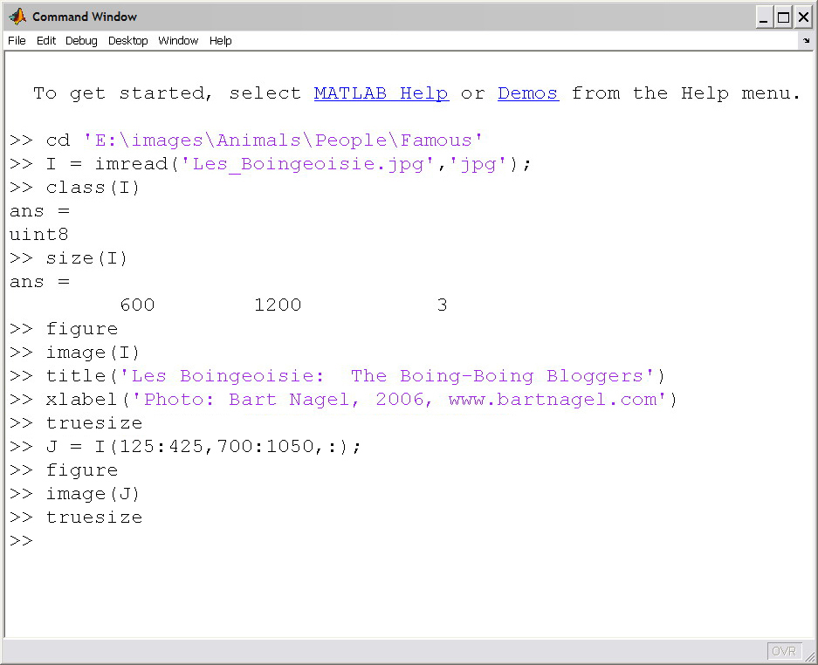
Read a Truecolor Image into Matlab
truesize makes the figure window fit the image – unless the images is too large for the display in which case it is resized to fit but with the correct aspect ratio.

Slide 46
Read a Truecolor Image into Matlab
http://boingboing.net/
David Pescovitz
Cory Doctorow
Mark Frauenfelder
John Battelle
Xeni Jardin

Slide 47

Crop the Image
How to crop an image using Matlab’s native indexing
First, select a region using the magnifier.
left click here and hold
Cut out a region from the image
drag to here and release

Slide 48
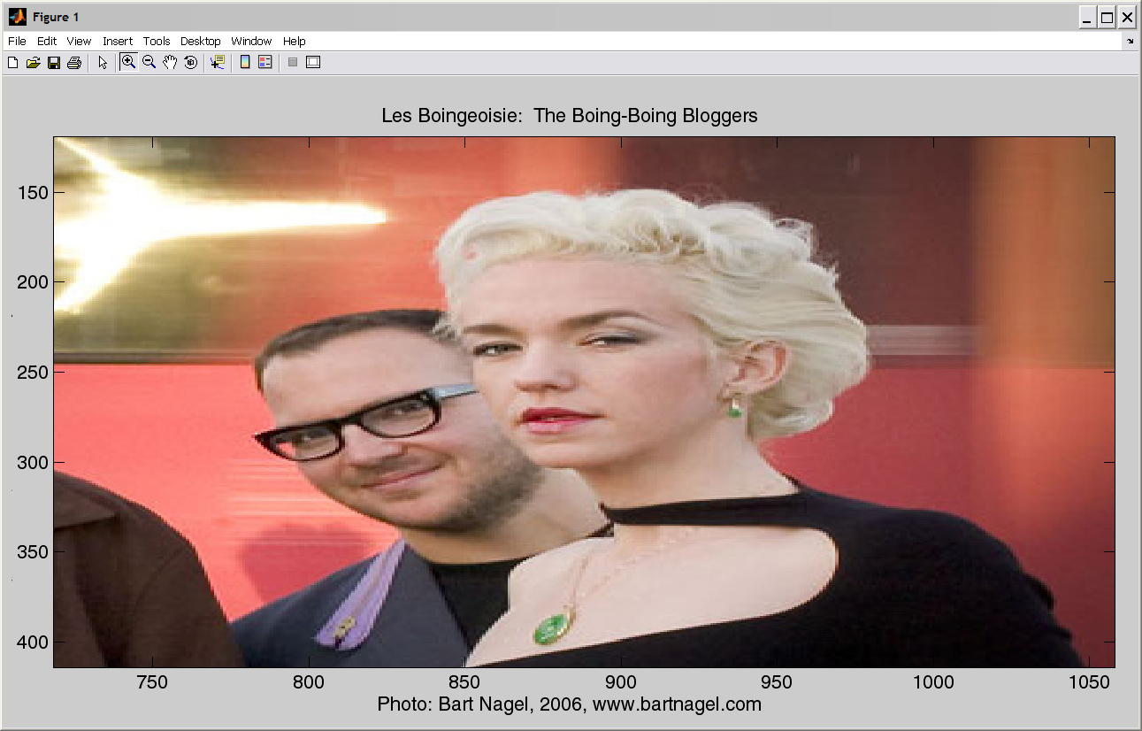
Crop the Image
From this close-up we can estimate the coordinates of the region:
rows: about 125 to 425 cols: about 700 to 1050

Slide 49
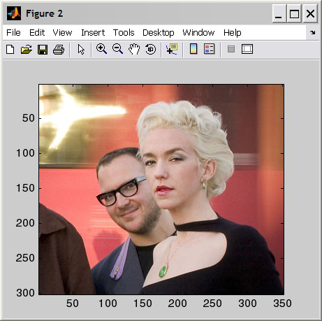
Crop the Image
I(:) means all I’s elements in a vertical list: 1st col followed by 2nd, etc. until the 1st band is catenated. Same procedure is applied to remaining bands for one long list.
Here it is:
J = I(first row:last row, first column:last column, all bands) ‘:’ alone means ‘all bands’ here. In the 1st position, ‘:’ means ‘all rows’; in the 2nd it means ‘all columns’.
Now to close figure 1…

Slide 50
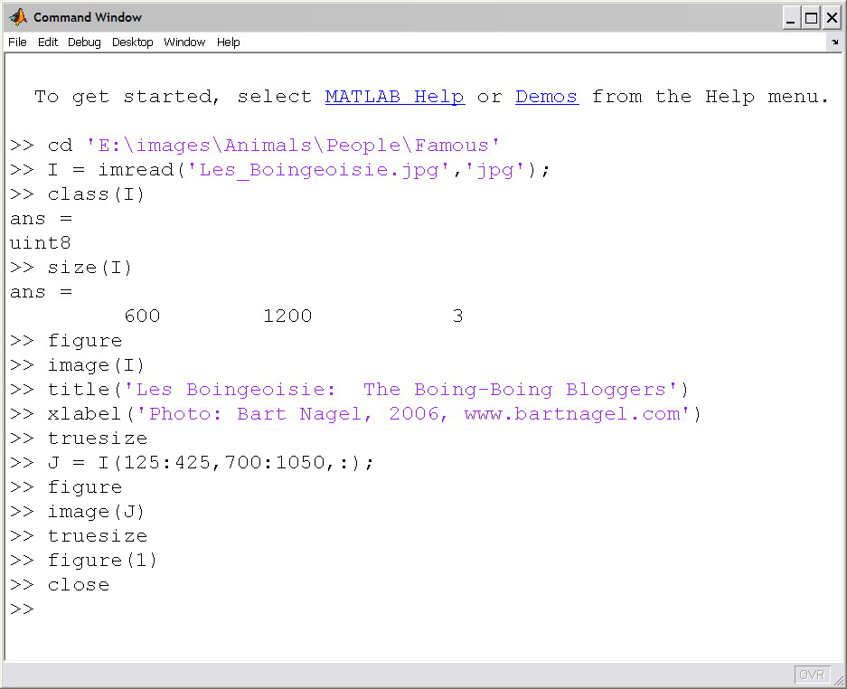
Crop the Image
… Bring figure 1 to the front using the figure() command,

Slide 51
Crop the Image
then type ‘close’ at the prompt.

Slide 52
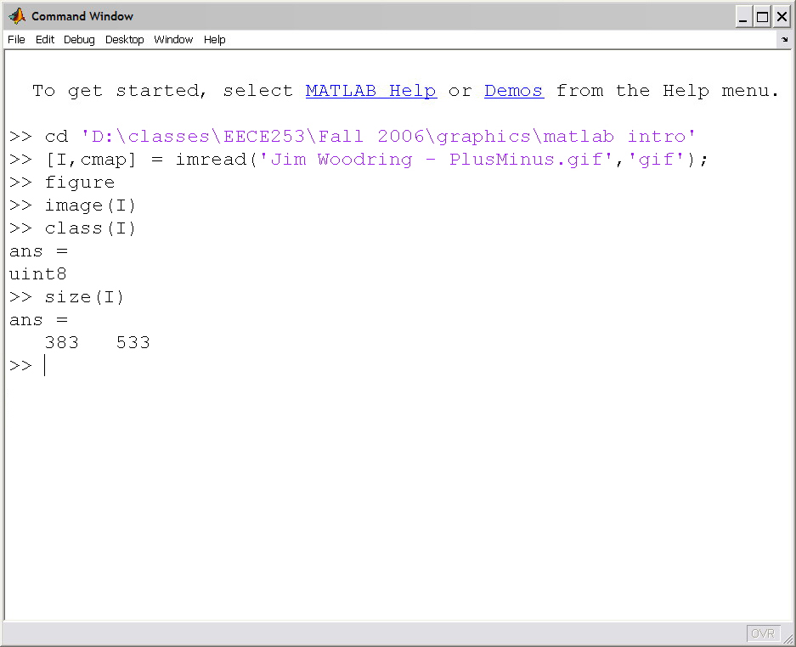

Read a Colormapped Image into Matlab
A colormap is an n X 3 table of color values. 8-bits per pixel implies n = 256 (at most) colors out of 256³ = 16777216
A colormapped image is a rectangular array of indices into a color map.
Matlab assumes that a 1-band, 8-bit / pixel image is colormapped. Initial display uses a default colormap which is highly likely to be incorrect for any given image.

Slide 53


Read a Colormapped Image into Matlab
Read the correct colormap from the image file along with the index array.
[I, cmap]=imread(…
I = index array
8-bit colormapped
cmap = colormap
Display the index array using image(). Then load the colormap using colormap().

Slide 54


Colormapped vs. Truecolor in Matlab
24-bit truecolor
8-bit colormapped

Slide 55
Colormapped vs. Truecolor in Matlab
24-bit truecolor
8-bit colormapped

Slide 56



Colormapped vs. Truecolor in Matlab
Intensity values are integers between 0 and 255.
T(231,326,:)
col: 326
image class: uint8
image type: truecolor
row: 231

Slide 57

Colormapped vs. Truecolor in Matlab
Intensity values are numbers between 0 and 1.
T(231,326,:)
col: 326
image class: double
image type: truecolor
row: 231

Slide 58


Colormapped vs. Truecolor in Matlab
Number at pixel location is an index into a colormap.
Intensity values are integers between 0 and 1.
1
colormap
…
…
…
…
0.1804 0.1882 0.0627
0.6863 0.7098 0.2902
0.8863 0.9059 0.2549
I(231,326,:) =
214
×
255
[226 231 65]^{T}
=
…
…
…
…
256
red green blue
col: 326
row: 231
image class: uint8
image type: colormapped

Slide 59

Example truecolor and colormapped images
24-bit truecolor
8-bit colormapped to 24 bits

Slide 60

Example truecolor and colormapped images
24-bit truecolor
8-bit colormapped to 24 bits

Slide 61


Colormapped Image, Indices, & Color Map
>> [M,CMAP] = imread(‘button_mapped.bmp’,’bmp);
Indices contained in M(254:258,254:258)
actual values in CMAP(109:113,:)
… 111 121 48 111 48 …
… 110 48 111 110 111 …
… 110 111 121 48 121 …
… 121 48 110 111 48 …
… 110 121 48 121 110 …
109 0.6588 0.4706 0.8471
110 0.2196 0.1569 0.2824
111 0.4706 0.3451 0.5961
112 0.5333 0.4078 0.6588
113 0.2824 0.2196 0.3451
…
…
…
…
…
…
R
…
G
…
B
…
…
…
…
…
…
…
…
…
…
…
255*CMAP(109:113,:)
109 168 120 216
110 56 40 72
111 120 88 152
112 136 104 168
113 72 56 88
R
G
B
…
…
…
…
Last 3 cols. only
…
…
…
…

Slide 62
How to convert a colormapped image to true color
M is a 512x512x1, 8-bit image.
It has 262,144 pixels.
Each pixel has a value between 0 & 255.
cmap is the colormap that is stored in ‘button_mapped.bmp’ along with image. cmap is a 256x3 type-double matrix, each row of which lists a color in terms of its R, G, & B intensities, which are given as fractions between 0 and 1.
>> [M,cmap] = imread(‘button_mapped.bmp’,‘bmp’);
>> T = uint8(reshape(cmap(M+1,:),[size(M) 3])*255);
[512 512]
The 262,144 x 3 matrix of intensity values is reshaped into a 512x512x3 image of type double. The values are scaled to lie between 0 & 255 then converted to type uint8.
By concatenating M’s columns, Matlab rearranges M into a 262,144 x 1 list. Each number in the list (if it has 1 added to it) refers to a row of the colormap. Then, cmap(M+1,:) produces a 262,144 x 3 matrix of intensity values of type double between 0 & 1.

Slide 63
How to Make Colormaps
This code, 0:255 ,
generates a 1 row by 256 element vector of class double that contains numbers 0 through 255 inclusive.
>> ramp = (0:255)'/255;
>> kcm = [ramp ramp ramp];
>>
>>
>>
>> rcm = [ramp zeros(256,2)];
>>
>>
>>
>> gcm = [zeros(256,1) ramp zeros(256,1)];
>>
>>
>>
>> bcm = [zeros(256,2) ramp ];
>>
>>
>> % apply one by selecting the figure
>> % then entering:
>>
>> colormap(kcm)
0
0.0039
0.0078
0.0118
0.0157
0.98430.98820.99220.99611.0000
gray colormap: R(k)=G(k)=B(k)
256 × 3 matrix
red colormap: G = B = 0;
…
green colormap: R = B = 0;
This, (0:255)’ , has the same contents and class but is a 256 row by 1 column vector. The apostrophe (‘) is the matrix transpose operator.
blue colormap: R = G = 0;

Slide 64




R, G, & B bands of a truecolor image displayed with grayscale colormaps
>> I = imread('blue_grapes_sm.jpg','jpg');
>> Rd = I(:,:,1);
>> colormap(kcm);
>> Gn = I(:,:,2);
>> colormap(kcm);
>> Bl = I(:,:,3);
>> colormap(kcm);

Slide 65
R, G, & B bands of a truecolor image displayed with grayscale colormaps
>> I = imread('blue_grapes_sm.jpg','jpg');
>> Rd = I(:,:,1);
>> colormap(kcm);
R
>> Gn = I(:,:,2);
>> colormap(kcm);
>> Bl = I(:,:,3);
>> colormap(kcm);
G
B

Slide 66



R, G, & B bands of a truecolor image displayed with tinted colormaps
>> I = imread('blue_grapes_sm.jpg','jpg');
>> Rd = I(:,:,1);
>> colormap(rcm);
>> Gn = I(:,:,2);
>> colormap(gcm);
>> Bl = I(:,:,3);
>> colormap(bcm);

Slide 67
R, G, & B bands of a truecolor image displayed with tinted colormaps
>> I = imread('blue_grapes_sm.jpg','jpg');
>> Rd = I(:,:,1);
>> colormap(rcm);
R
>> Gn = I(:,:,2);
>> colormap(gcm);
>> Bl = I(:,:,3);
>> colormap(bcm);
G
B

Slide 68
R, G, & B bands of a truecolor image displayed with grayscale colormaps
>> I = imread('blue_grapes_sm.jpg','jpg');
>> Rd = I(:,:,1);
>> colormap(kcm);
R
>> Gn = I(:,:,2);
>> colormap(kcm);
>> Bl = I(:,:,3);
>> colormap(kcm);
G
B

Slide 69
Saving Images as Files
>>
>> % truecolor as .bmp
>> imwrite(I,’image_name.bmp’,’bmp’);
>>
>> % truecolor as .jpg (default quality = 75)
>> imwrite(I,’image_name.jpg’,’jpg’);
>>
>> % truecolor as .jpg (quality = 100)
>> imwrite(I,’image_name.jpg’,’jpg’,’Quality’,100);
>>
>> % colormapped as .bmp
>> imwrite(I,cmap,’image_name.bmp’,’bmp’);
>>
>> % colormapped as .gif
>> imwrite(I,cmap,’image_name.gif’,’gif’);
>>
Assuming that
‘I’ contains the image of the correct class,
that
‘cmap’ is a colormap,
and that
‘image_name’ is the file-name that you want.

Slide 70



Double Exposure: Adding Two Images
Jim Woodring - Bumperillo
Rayden Woodring – The Ecstasy of Bumperillo (?)
Mark Rayden – The Ecstasy of Cecelia

Slide 71
Double Exposure: Adding Two Images
>> cd 'D:\Classes\EECE253\Fall 2006\Graphics\matlab intro'
>> JW = imread('Jim Woodring - Bumperillo.jpg','jpg');
>> figure
>> image(JW)
>> truesize
>> title('Bumperillo')
>> xlabel('Jim Woodring')
>> MR = imread('Mark Ryden - The Ecstasy of Cecelia.jpg','jpg');
>> figure
>> image(MR)
>> truesize
>> title('The Ecstasy of Cecelia')
>> xlabel('Mark Ryden')
>> [RMR,CMR,DMR] = size(MR);
>> [RJW,CJW,DJW] = size(JW);
>> rb = round((RJW-RMR)/2);
>> cb = round((CJW-CMR)/2);
>> JWplusMR = uint8((double(JW(rb:(rb+RMR-1),cb:(cb+CMR-1),:))+double(MR))/2);
>> figure
>> image(JWplusMR)
>> truesize
>> title('The Ecstasy of Bumperillo')
>> xlabel('Jim Woodring + Mark Ryden')
Example Matlab Code

Slide 72
Double Exposure: Adding Two Images
>> cd 'D:\Classes\EECE253\Fall 2006\Graphics\matlab intro'
>> JW = imread('Jim Woodring - Bumperillo.jpg','jpg');
>> figure
>> image(JW)
>> truesize
>> title('Bumperillo')
>> xlabel('Jim Woodring')
>> MR = imread('Mark Ryden - The Ecstasy of Cecelia.jpg','jpg');
>> figure
>> image(MR)
>> truesize
>> title('The Ecstasy of Cecelia')
>> xlabel('Mark Ryden')
>> [RMR,CMR,DMR] = size(MR);
>> [RJW,CJW,DJW] = size(JW);
>> rb = round((RJW-RMR)/2);
>> cb = round((CJW-CMR)/2);
>> JWplusMR = uint8((double(JW(rb:(rb+RMR-1),cb:(cb+CMR-1),:))+double(MR))/2);
>> figure
>> image(JWplusMR)
>> truesize
>> title('The Ecstasy of Bumperillo')
>> xlabel('Jim Woodring + Mark Ryden')
Example Matlab Code
Cut a section out of the middle of the larger image the same size as the smaller image.

Slide 73
Double Exposure: Adding Two Images
>> cd 'D:\Classes\EECE253\Fall 2006\Graphics\matlab intro'
>> JW = imread('Jim Woodring - Bumperillo.jpg','jpg');
>> figure
>> image(JW)
>> truesize
>> title('Bumperillo')
>> xlabel('Jim Woodring')
>> MR = imread('Mark Ryden - The Ecstasy of Cecelia.jpg','jpg');
>> figure
>> image(MR)
>> truesize
>> title('The Ecstasy of Cecelia')
>> xlabel('Mark Ryden')
>> [RMR,CMR,DMR] = size(MR);
>> [RJW,CJW,DJW] = size(JW);
>> rb = round((RJW-RMR)/2);
>> cb = round((CJW-CMR)/2);
>> JWplusMR = uint8((double(JW(rb:(rb+RMR-1),cb:(cb+CMR-1),:))+double(MR))/2);
>> figure
>> image(JWplusMR)
>> truesize
>> title('The Ecstasy of Bumperillo')
>> xlabel('Jim Woodring + Mark Ryden')
Example Matlab Code
Note that the images are averaged, pixelwise.

Slide 74
Double Exposure: Adding Two Images
>> cd 'D:\Classes\EECE253\Fall 2006\Graphics\matlab intro'
>> JW = imread('Jim Woodring - Bumperillo.jpg','jpg');
>> figure
>> image(JW)
>> truesize
>> title('Bumperillo')
>> xlabel('Jim Woodring')
>> MR = imread('Mark Ryden - The Ecstasy of Cecelia.jpg','jpg');
>> figure
>> image(MR)
>> truesize
>> title('The Ecstasy of Cecelia')
>> xlabel('Mark Ryden')
>> [RMR,CMR,DMR] = size(MR);
>> [RJW,CJW,DJW] = size(JW);
>> rb = round((RJW-RMR)/2);
>> cb = round((CJW-CMR)/2);
>> JWplusMR = uint8((double(JW(rb:(rb+RMR-1),cb:(cb+CMR-1),:))+double(MR))/2);
>> figure
>> image(JWplusMR)
>> truesize
>> title('The Ecstasy of Bumperillo')
>> xlabel('Jim Woodring + Mark Ryden')
Example Matlab Code
Note the data class conversions.

Slide 75

Intensity Masking: Multiplying Two Images
Jim Woodring - Bumperillo
Rayden Woodring – Bumperillo Ecstasy (?)
Mark Rayden – The Ecstasy of Cecelia

Slide 76
Intensity Masking: Multiplying Two Images
>> JW = imread('Jim Woodring - Bumperillo.jpg','jpg');
>> MR = imread('Mark Ryden - The Ecstasy of Cecelia.jpg','jpg');
>> [RMR,CMR,DMR] = size(MR);
>> [RJW,CJW,DJW] = size(JW);
>> rb = round((RJW-RMR)/2);
>> cb = round((CJW-CMR)/2);
>> JWplusMR = uint8((double(JW(rb:(rb+RMR-1),cb:(cb+CMR-1),:))+double(MR))/2);
>> figure
>> image(JWplusMR)
>> truesize
>> title('The Extacsy of Bumperillo')
>> xlabel('Jim Woodring + Mark Ryden')
>> JWtimesMR = double(JW(rb:(rb+RMR-1),cb:(cb+CMR-1),:)).*double(MR);
>> M = max(JWtimesMR(:));
>> m = min(JWtimesMR(:));
>> JWtimesMR = uint8(255*(double(JWtimesMR)-m)/(M-m));
>> figure
>> image(JWtimesMR)
>> truesize
>> title('EcstasyBumperillo')
Example Matlab Code

Slide 77
Intensity Masking: Multiplying Two Images
>> JW = imread('Jim Woodring - Bumperillo.jpg','jpg');
>> MR = imread('Mark Ryden - The Ecstasy of Cecelia.jpg','jpg');
>> [RMR,CMR,DMR] = size(MR);
>> [RJW,CJW,DJW] = size(JW);
>> rb = round((RJW-RMR)/2);
>> cb = round((CJW-CMR)/2);
>> JWplusMR = uint8((double(JW(rb:(rb+RMR-1),cb:(cb+CMR-1),:))+double(MR))/2);
>> figure
>> image(JWplusMR)
>> truesize
>> title('The Extacsy of Bumperillo')
>> xlabel('Jim Woodring + Mark Ryden')
>> JWtimesMR = double(JW(rb:(rb+RMR-1),cb:(cb+CMR-1),:)).*double(MR);
>> M = max(JWtimesMR(:));
>> m = min(JWtimesMR(:));
>> JWtimesMR = uint8(255*(double(JWtimesMR)-m)/(M-m));
>> figure
>> image(JWtimesMR)
>> truesize
>> title('EcstasyBumperillo')
Example Matlab Code
Note that the images are multiplied, pixelwise.
Note how the image intensities are scaled back into the range 0-255.

Slide 78


A note on image intensity scaling
In the code on the previous slide we scaled the result of the image multiplication so that it would have the maximum possible dynamic range (0-255). The formula for such linear scaling is
I
J
In Matlab, if the images are of type uint8, this requires class conversions:
J = uint8(255*double(I-m)/double(M-m));
Without the double casts, the arithmetic is performed with 8 bits of precision, which yields incorrect results.

Slide 79
A note on image intensity scaling
In the code on the previous slide we scaled the result of the image multiplication so that it would have the maximum possible dynamic range (0-255). The formula for such linear scaling is
In Matlab, the min and max are computed like this:
m = min(I(:)); M = max(I(:));
I
J
In Matlab, if the images are of type uint8, this requires class conversions:
J = uint8(255*double(I-m)/double(M-m));
Without the double casts, the arithmetic is performed with 8 bits of precision, which yields incorrect results.

Slide 80




More on image intensity scaling
Linear scaling is not always appropriate. If the image has some important features with very low intensity values and others that are large, the darker features may not be visible in a linearly scaled result. In such cases nonlinear scaling can perform better. The images below are differently scaled versions of D = abs(I-J); where I is the image to the left and J was a quality-0 jpeg copy of itself.
uint8(255*(D-m)/(M-m)))
L=log(D+1),uint8(255*L/max(L(:))
uint8(D.^2)

Slide 81

Pixel Indexing in Matlab
“IP_Function” is some arbitrary image processing function that you or someone else has written.
“For” loops in Matlab are inefficient, whereas Matlab’s native indexing procedures are very fast.
Rather than
for r = 1:R
for c = 1:C
J(r,c,:) = IP_Function(I(r,c,:));
end
end
use, if possible
J = IP_Function(I);
But, sometimes that is not possible.
For example, if the output, J, is decimated with respect to the input, I, the above will not work (unless, of course, it is done within IP_function).

Slide 82



Pixel Indexing in Matlab
Here, n=3
r = [1 4 7 10 13 16 19 22 25 28 31]
r = 1:n:R;
I(r,:,:)
c = 1:n:C;
I(:,c,:)
c = [1 4 7 10 13 16 19 22 25 28 31]
To decimate the above image by a factor of n, create a vector, r, that contains the index of every nth row, and a similar vector, c.

Slide 83


Pixel Indexing in Matlab
Here, n=3
Take the pixels indexed by both r and c.
This is called, ‘vectorizing’.
I(r,c)
Then, vectors r and c used as index arguments for image I select every nth column in every nth row.

Slide 84

Pixel Indexing in Matlab
Here, n=3
J = I(r,c,:);
image, I
r = 1:n:R;
c = 1:n:C;

Slide 85

Pixel Indexing in Matlab
Indexing in Matlab is fully general.
If I is R x C x B, vectors r and c can contain any numbers 1 ≤ r_{k} ≤ R and 1 ≤ c_{k} ≤ C.
The numbers can be in any order and can be repeated within r and c.
The result of I(r,c) is an ordinal shuffling of the pixels from I as indexed by r and c.
Whenever possible, avoid using ‘for’ loops; vectorize instead.

Slide 86

Pixel Indexing in Matlab
Indexing in Matlab is fully general.
If I is R x C x B, vectors r and c can contain any numbers 1 ≤ r_{k} ≤ R and 1 ≤ c_{k} ≤ C.
The numbers can be in any order and can be repeated within r and c.
The result of I(r,c) is an ordinal shuffling of the pixels from I as indexed by r and c.
Whenever possible, avoid using ‘for’ loops; vectorize instead.

Slide 87

Pixel Indexing in Matlab
Indexing in Matlab is fully general.
If I is R x C x B, vectors r and c can contain any numbers 1 ≤ r_{k} ≤ R and 1 ≤ c_{k} ≤ C.
The numbers can be in any order and can be repeated within r and c.
The result of I(r,c) is an ordinal shuffling of the pixels from I as indexed by r and c.
Whenever possible, avoid using ‘for’ loops; vectorize instead.

Slide 88

Pixel Indexing in Matlab
Indexing in Matlab is fully general.
If I is R x C x B, vectors r and c can contain any numbers 1 ≤ r_{k} ≤ R and 1 ≤ c_{k} ≤ C.
The numbers can be in any order and can be repeated within r and c.
The result of I(r,c) is an ordinal shuffling of the pixels from I as indexed by r and c.
Whenever possible, avoid using ‘for’ loops; vectorize instead.

Slide 89

Pixel Indexing in Matlab
Indexing in Matlab is fully general.
If I is R x C x B, vectors r and c can contain any numbers 1 ≤ r_{k} ≤ R and 1 ≤ c_{k} ≤ C.
The numbers can be in any order and can be repeated within r and c.
The result of I(r,c) is an ordinal shuffling of the pixels from I as indexed by r and c.
Whenever possible, avoid using ‘for’ loops; vectorize instead.

Slide 90

Pixel Indexing in Matlab
Indexing in Matlab is fully general.
If I is R x C x B, vectors r and c can contain any numbers 1 ≤ r_{k} ≤ R and 1 ≤ c_{k} ≤ C.
The numbers can be in any order and can be repeated within r and c.
The result of I(r,c) is an ordinal shuffling of the pixels from I as indexed by r and c.
Whenever possible, avoid using ‘for’ loops; vectorize instead.

Slide 91

Pixel Indexing in Matlab
>> I = imread('Lawraa - Flickr - 278635073_883bd891ec_o.jpg','jpg');
>> size(I)
ans =
576 768 3
>> r = randperm(576);
>> c = randperm(768);
>> J = I(r,c,:);
>> figure
>> image(J)
>> truesize
>> title('Scrambled Image')
>> xlabel('What is it?')
Fun (if you’re an imaging geek) thing to try with Matlab indexing: Scramble an image!

Slide 92

Pixel Indexing in Matlab
The image can be unscrambled using the row and column permutation vectors, r & c.
>> …
>> xlabel('What is it?')
>> K(r,c,:) = J;
>> figure
>> image(K)
>> truesize
>> title('Yay!!!')
>> xlabel('Photo: Lawraa on Flickr.com')

Slide 93
Matlab Vectorization
“tic” starts Matlab’s code timer. “toc” stops the timer and reports the elapsed time.
Making a Matlab program run as fast as possible fast by avoiding loops is called “vectorization.” It is not something that Matlab does automatically. Rather it is a skill that a good programmer learns.
Looped code
Vectorized code
tic
for t = 1:1024
y(t) = sin(2*pi*t/512);
end
toc
Elapsed time is 0.038923 seconds.
tic
y = sin(pi*(0:(1/256):2));
toc
Elapsed time is 0.002019 seconds.
0.038923 / 0.002019 = 19.2784 ⇒ vectorized code is 20 times faster the looped!
There is a web page on vectorization at the MathWorks:
http://www.mathworks.com/help/matlab/matlab_prog/vectorization.html

Slide 94
Matlab Vectorization
Example: compute a distance matrix, the matrix of squared pair-wise distances between two sets of vectors.

Slide 95
Matlab Vectorization
Looped code
Example: compute a distance matrix.
tic
for r = 1:1000
for c = (r+1):1000
diff = A(:,r)-B(:,c);
D(r,c) = diff'*diff;
end
end
D = D + D';
toc
bsxfun(function,A,B) applies the binary operation specified by function, to matrices A and B.
Elapsed time is 4.893803 seconds.
Vectorized code
Elapsed time is 0.009223 seconds.
tic
D = bsxfun(@plus,sum(A.^2)',bsxfun(@plus,sum(B.^2),-2*(A'*B)));
toc
4.893803 / 0.009223 = 530.609 ⇒ vectorized code is 530 times faster the looped!

